Slide 1

Management Capability Need Analysis (MCNA)
Focus Group
REUTERS / Molly Riley
Emily Finch, Host
Abigail Mirarchi, Facilitator
May 10, 2017
Notes:
SAY
Hello!
Welcome!
Hello and welcome!

Slide 2
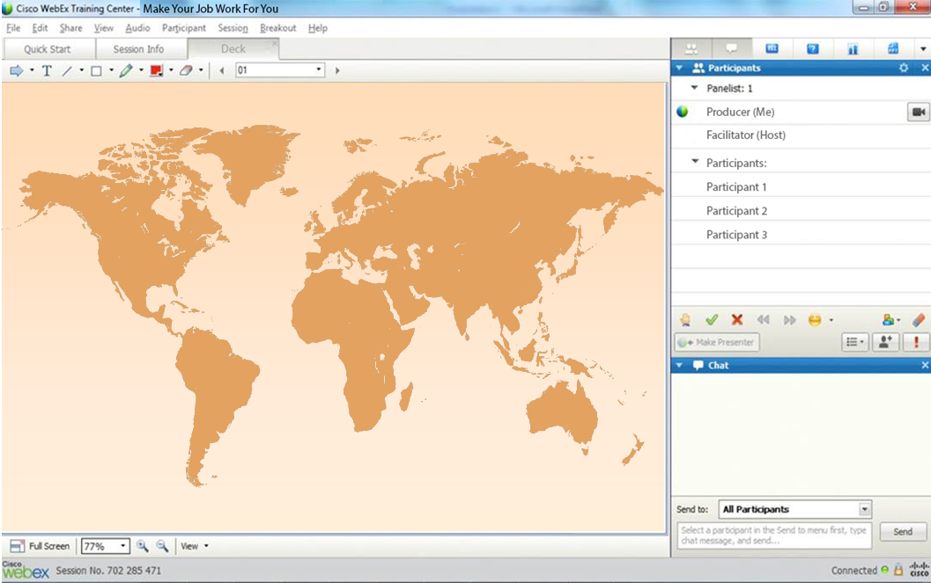
WebEx Environment Reminders
Notes:
EMILY
Hello and welcome everyone for joining us!
ASK
Click on the pointer tool in the upper Left corner of your WebEx window and then click on your location of where you are currently located, as people join will know where we are all!
Thank you for joining today we will start momentarily.
Great! Thank you!

Slide 3
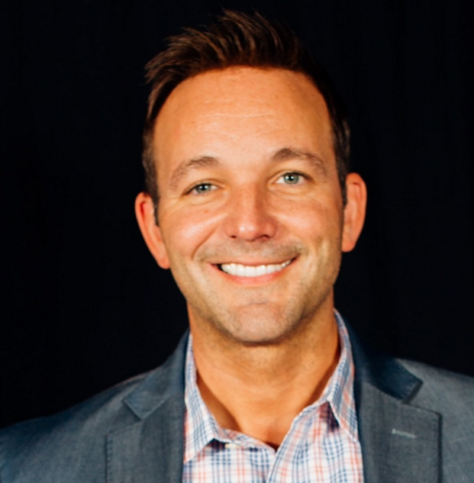
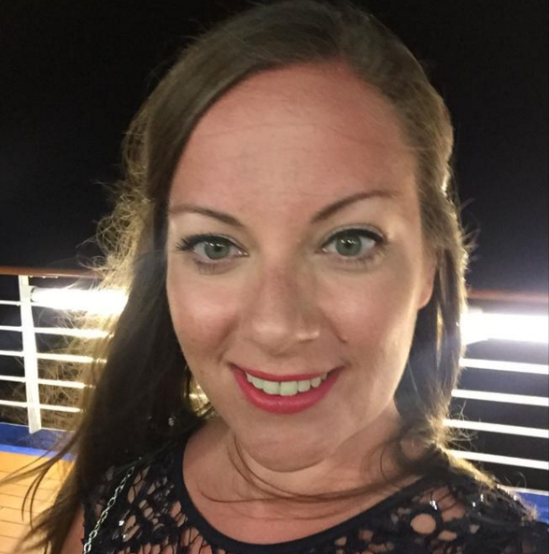
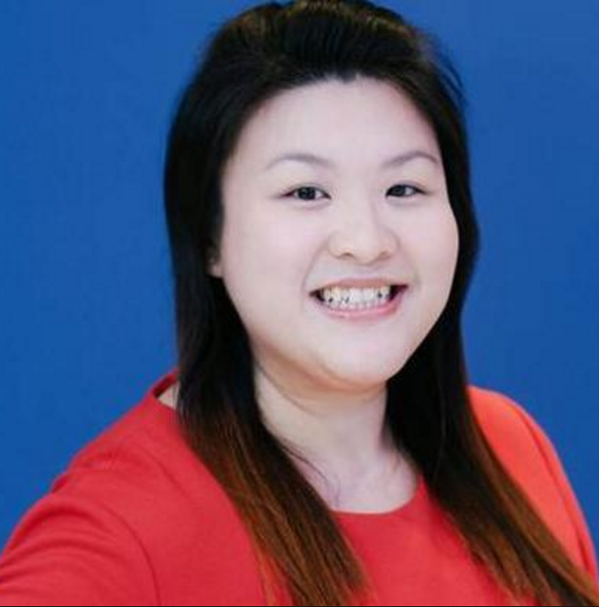
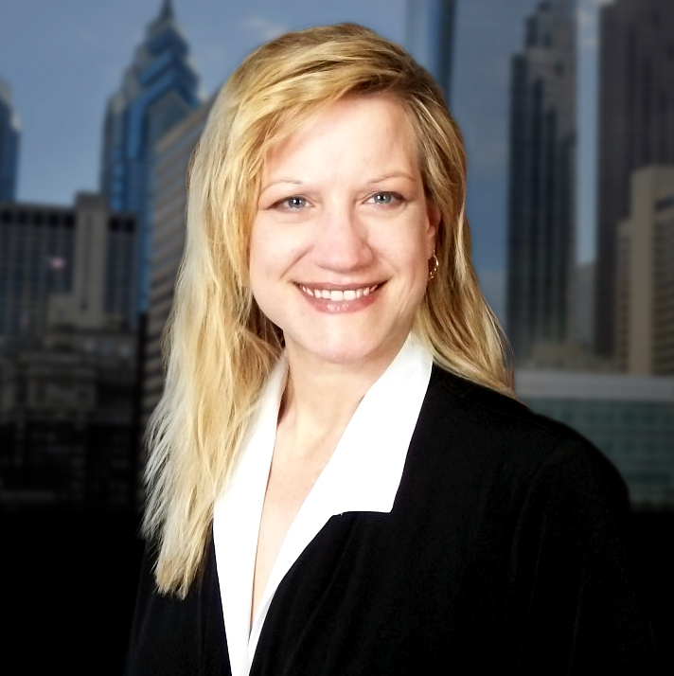
Welcome and Introductions
Keith Puliafico
Senior Director,
Talent & Development
Interim POC - LatAM
(AMER-DC)
Emily Finch
Manager,
Talent & Development
Manager Capability
(London)
Grace Seng
Senior Learning & Development
Manager - APAC
(Singapore)
Abigail Mirarchi
Senior Talent & Development
Analyst - Instructional Designer
(AMER-PA)
Notes:
EMILY
My name is Emily Finch and I am your host for today’s focus group.
I am glad to have an opportunity to meet all of you. Let me start with some brief introductions before we begin today.
I have been working for Thomson Reuters for 9 years. Some of my more notable roles include working for the Technology Operations based in London, the Sales organization as a Project Manager and then overseeing the HR Sales Graduate Program. For the last three years I have been leading the Management Capability domain area of Learning. Our current management audience spans over 7,632 leaders. Our MaTR program touches 5, 211 and 2,421 for our AMaTR audience.
We are also joined by Abigail Mirarchi. Abigail is our facilitator.
------------------------------
Abigail
Thank you Emily. Welcome everyone.
I am the Senior Talent & Development Analyst for learning. I am primarily responsible for all aspect of learning support. I analyze training programs and offerings, partner to create learning courses and resources and assist in delivering learning products that are fit for purpose. I will also be guiding today’s discussion.
Before we get started, let me also familiarize you with a few other people on our team. Keith Pulicafico, is our Senior Director of Talent and Development and Grace Seng, Senior Manager partner for our APAC region.
From everyone from Talent and Development, thank you for attending todays focus group.
Phone lines are, and will remain, open. If you anticipate background noise, please mute your microphone.

Slide 4
WebEx Environment Reminders
Notes:
SAY
Okay, now it is our time to get to know you a little more, while we review a few tools we will use today. The Pointer, Green Check Mark/Red X and the Chat window.
SAY
Below the tool bar is the chat box. In the Chat Box, Where it says, Send to: keep the default to “All Participants”. During this focus group feel free to answer questions using this method.
ASK
In the chat window, type a brief introduction that includes your business unit and role at Thomson Reuters and how long you have been a leader at Thomson Reuters.
SAY
Above the Chat are two icons, a green check mark and red X.
SAY
Our focus group has been scheduled for approximately 90-minutes. If you are unable to stay with us the entire time due to prior commitments, we completely understand. Please accept our deepest gratitude for your participation ahead of time.
If you need to step away, please use the coffee/tea cup to represent you have stepped away from this focus group.
ASK
Click the green check mark if you are comfortable using todays three tools.
Great! Thank you!

Slide 5
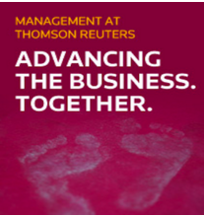
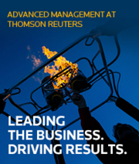
Introduction and History
MANAGEMENT AT THOMSON REUTERS (MaTR):
Enable first-line managers to drive employee engagement by focusing on fundamental people management skills.
ADVANCED MaTR (AMaTR):
Understand expectations of TR leaders and develop business / strategic acumen capabilities and skills to execute our strategy while building high performing teams.
Notes:
SAY
As you may know, Thomson Reuters invests in Manager Capability provides skills and leadership techniques through various tools and resources that align with Thomson Reuter’s values.
Our flagship programs for Manager Capability are MaTR & AMaTR programs.
These are exciting times where we have successfully established the foundations in both our MaTR and AMaTR programs.
Let me provide you a little history of our Management Capability Programs
We launched our global management capability programs, Management at Thomson Reuters (MaTR) in 2013 and Advanced Management at Thomson Reuters (AMaTR) 2014.
These programs have reached more than 9,000 leaders to-date.
The investment has increased productivity and manager effectiveness where by:
MaTR participation is positively correlated with both higher Manager Effectiveness Survey results for participants and higher Employee Engagement scores amongst direct reports of participants.
MaTR program Return on Investment (ROI) is conservatively estimated at 43%. (That is, for every $1 spent, $1.43 is returned to Thomson Reuters).
Among AMaTR participants, 98% applied what they learned and 68% reported significantly or worthwhile results for their unit (such as, increased revenues and cost savings).
AMaTR has resulted in a 148% Return on Investment (ROI) (where by, for every $1 spent, $2.48 is returned to Thomson Reuters).

Slide 6


Purpose and Strategy Overview
“With your support,
today’s conversation will allow us valuable insight on the leader learning journey.
With your partnership,
our goal is to continually provide tools and resources to help address the needs of our global front line managers and leaders.
Notes:
SAY
As part of our 2017 strategy our goal is to validate our current offerings are fit for purpose, while identifying emerging areas in both MaTR and AMaTR programs. We will focus on what needs to be developed, maintained, and enhanced to lead high performing global teams into 2018 and beyond.
When our Manager Capability Needs Analysis is complete, we will make recommendations for sustainable cost effective solutions to address gaps and opportunities for the areas that will have the largest influence on business performance.
We are grateful for your time with us today.
We will cover common themes and ask you questions about your observations, needs, and recommendations of the programs.
With your support, today’s conversation will allow us valuable insight on the leader learning journey.
With your partnership, our goal is to continually provide tools and resources to help address the needs of our global front line managers and leaders.
SAY
In order to ensure we are able to capture your feedback, ideas, suggestions and recommendations accurately, we would like to record this focus group. The recording, content and all discussions will be held in the strictest of confidence and will only be used to capture the information we need to make the appropriate recommendations and enhancements to the programs.
Do I have your support in recording today’s session?
ASK
Use the green check mark for yes, and the red x for no.

Slide 7
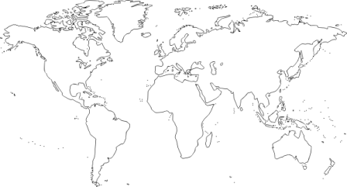
Share a little about your experiences.
What specific skills or resources did you find necessary to have when you became as a Sr. Leader?
Notes:
Animation
SAY
Share a little about your experiences.
What specific skills or resources did you find necessary to have when you became as a Sr. Leader?
ASK
Which skill areas / learning content was not provided that you were expecting, or needed for your role?
Who did you contact or where did you obtain support to your needs?
ASK
Are there any additional responses?

Slide 8
The current MaTR Summit is offered two ways: One Day (Face to Face) or two half days (Virtual). The summit includes 2 Skill Sessions: Courageous Conversations & Your Impact on Others
10 additional Skill Management Sessions available:
Beyond Unconscious Bias
Building Virtual Teams
Career Conversations
Coaching for performance
Differentiating performance
Dynamic Delegation
Frequent Feedback
Goal Setting
Innovate
Leading Change
Notes:
SAY
The current MaTR Summit is offered two ways: One Day (Face to Face) or two half days (Virtual). The summit includes 2 Skill Sessions: Courageous Conversations & Your Impact on Others
ASK
In your opinion, considering the topics 1 - 10, do you think a senior manager should have access to the content at anytime and skill sessions that are available in the MaTR program? (Green Check mark for YES/ Red X for NO)
And in the chat, provide your top 3 you think would be most valuable to have a deeper dive into for as a Sr. Leader.
Probing Question
Why did you answer the way you did?
*ASK
Are there any additional responses?

Slide 9
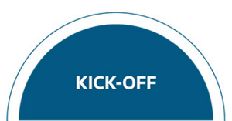



AMaTR Summit contains Summit 1: Leading Others (1-Day), Intersession Work (3-hours over 3-months) & Summit 2: Leading the Business (1-Day)
Self-paced pre-work Read the Leading Others Case Study
Review and complete Achieving Return on Strategy online module
Watch Leading @ Thomson Reuters Module Meet with your manager
Three rounds of Simulation
Aims:
Strategy
Translating high-level TR strategy into meaningful personal action
Developing Talent
Fostering a climate of innovation, risk taking and diversity of though
Creating a clear purpose to drive alignment & engagement
Managing and effecting change across the organization
Innovation
Challenging existing assumptions
Thinking differently about business models
Growing organically
Self -paced work in between Summits Force Field Analysis - To gain a deeper understanding of the strategy you and your team are driving. AMC Assessment - To assess the alignment, mindset, and capability of each individual team member as well as the collective team, in order to determine strategy execution readiness. Innovation Actions - To identify the actions that will have the greatest impact on creating an environment where innovation can flourish. Summit 1 Session Powerpoint Tech Trends Video: Big Data Tech Trends Video: Cloud Computing
Three rounds of simulation
Aims:
Broaden enterprise perspective
Strategic thinking
Increase customer and employee engagement focus,
Practice transforming the Thomson Reuters business
Apply financial and commercial acumen and leadership skills
Make business decisions and evaluate the trade offs
Immediately see the results through the financial, customer and people metrics
Notes:
Animated
SAY
AMaTR Summit is comprised of two, one-day sessions with intersession activities that spanned about 3-hours over 3-months.
Summit 1: Face-to-face 1-day session focused on building leadership skills that will help you be more effective at Leading Others.
Summit 2: Face-to-face 1-day session focused on stepping into the shoes of a senior leadership team and run the business over a three-year period.
ASK
Simply using your pointer tool, put your pointer tool below one of the three headings that made the most positive impact on you, your team, your experience in the AMaTR program.
Type your first initial responses into the Chat window to this question:
Summit 1 – Leading Others - Which skill areas / content were most valuable to you? And why?
Probing questions:
What skill topic isn’t/wasn’t provided that you would now expect to see or have observed that should be included? And Why?
Intersession Work - Which skill areas / content were most valuable to you? And why?
Summit 2 – Leading the Business - Which skill areas / content were most valuable to you? And why?
Probing questions:
What skill topic isn’t/wasn’t provided that you would now expect to see or have observed that should be included? And Why?
*ASK
Are there any additional responses?

Slide 10
AMaTR Summit contains Summit 1: Leading Others (1-Day), Intersession Work (3-hours over 3-months) & Summit 2: Leading the Business (1-Day)
Option 1
Keep AMaTR Summits as it is today. No change.
Option 2
Lengthen the duration of the Summits and incorporate additional content with practical activities.
Option 3
Something else?
Notes:
Think about the length and content covered in the AMaTR program and what we discussed thus far,
Type your first initial responses use your pointer to answer this statement:
If you had a choice would you:
OPTION 1: Keep AMaTR Summits as it is today. No change.
OPTION 2: Lengthen the duration of the Summits and incorporate additional content with practical activities.
OPTION 3: Something else?
*ASK
Are there any additional responses?

Slide 11
Think about where you find answers to the following topics.
While managing my team, I use resources from the following place(s) to help me with:
Recruitment
Communicating and modeling an enterprise mindset
Managing time off requests
Providing career development conversations
Performance management (goal setting and achievement)
Building a diverse and inclusive team environment
Coaching my employees
Notes:
Animation
SAY
Think about where you find answers to the following topics.
I will present 9 topics, one at a time. Be as specific as possible where you find, locate, your go-to resources or who you go to for the your resources/answers.
ASK
While managing my team, I use resources from the following place(s) to help me with:
Type your first initial responses into the Chat window.
Recruitment
Communicating and modeling an enterprise mindset
Managing time off requests
Providing career development conversations
Performance management (goal setting and achievement)
Building a diverse and inclusive team environment
Coaching my employees
Probing questions:
Which top 2 have been the most challenging to find or locate learning and resources?
Type your first initial responses into the Chat window.
*ASK
Are there any additional responses?

Slide 12
Share a little about your experience in role.
As part of your role, are you required to…
Make relevant business decisions by thinking commercially to achieve desired business outcomes? (e.g. risk/cost allocation, developing strategic plans, building partnering relationships, writing business proposals and requesting appropriate expertise)
Accurately formulate, analyze and interpret required financial reports? (e.g. profit and loss statements, profit margins, balance sheets and budgets)
Develop and execute a strategic vision across various levels of the organization?
Discuss and support the enterprise growth strategy to increase the customer experience?
Notes:
Animation
SAY
Think about questions you may have regarding the following topics.
I will present about 2-4 topics, one at a time. Be as specific as possible in your answers.
As part of your role, are you required to Make relevant business decisions by thinking commercially to achieve desired business outcomes?
As part of your role, are you required to accurately formulate, analyze and interpret required financial reports?
Develop and execute a strategic vision across various levels of the organization?
Discuss and support the enterprise growth strategy to increase the customer experience?
---------------------------------------------------------------
Use green check for yes, red x for no
[YES] What kind of financial reports are you formulating, analyzing and interpreting and how often?
[No] What is the reason why – (depending on business unit, needs, requirements of role, something else?)
Probing Questions:
[For No answers] Would you currently feel confident to be able to formulate, analyzing, and interpret financial reports?
When you have questions, “where” do you look for support and/or “Who” do you contact to get answers to your questions, or “what” do you ask?
Would you provide a few examples of questions that you ask or would ask?
If applicable, which learning or resources to you coin as “go-to” for answers?
Do you share / have conversations about the results with your team / emerging MaTR leaders? If not, why?
-------------------------------------------------------------
*ASK
Are there any additional responses?

Slide 13
Thank You
Notes:
SAY
On behalf of Talent and Development, we are honored and grateful for your time and support today. It is with your partnership, observations, and recommendations for the programs that will allow us the ability to provide tools and resources that is most important to you. Your input is extremely important and to the enterprise success.
If you have any further questions about todays session or would like to provide Emily Finch additional observation or recommendations, please feel free to contact her directly.
Thank you and have a wonderful rest of the day!
(Optional last question)
If you could design your next training course for the [Thomson Reuters enterprise, MaTR Program, AMaTR Program], what would the course look like, how long would it be, how and when would it be delivered and why?

