Slide 1

Management Capability Need Analysis (MCNA)
Focus Group
REUTERS / Molly Riley
Emily Finch, Host
Abigail Mirarchi, Facilitator
May 9, 2017
Notes:
SAY
Hello!
Welcome!
Hello and welcome!
Thank you for joining today we will start momentarily.

Slide 2
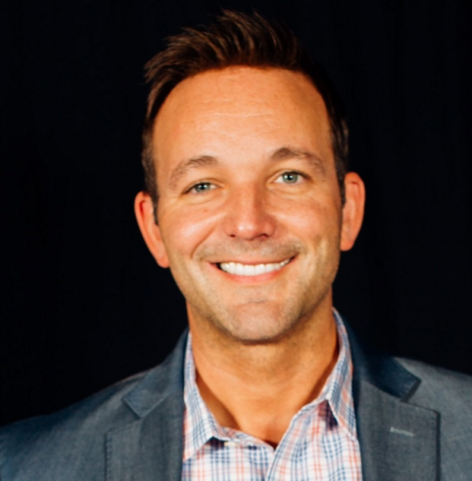
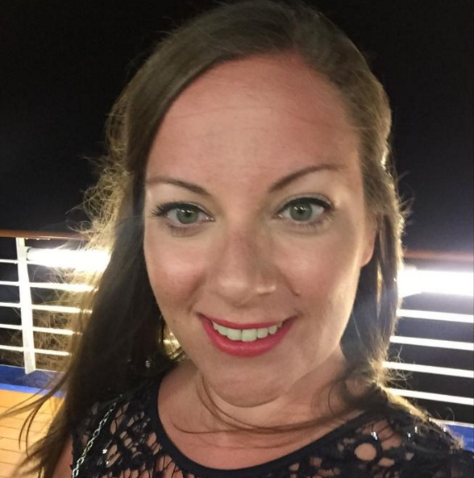
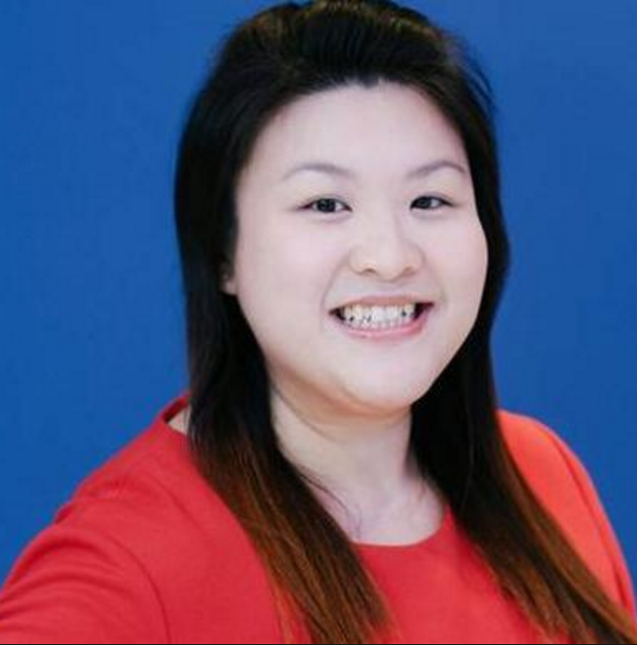
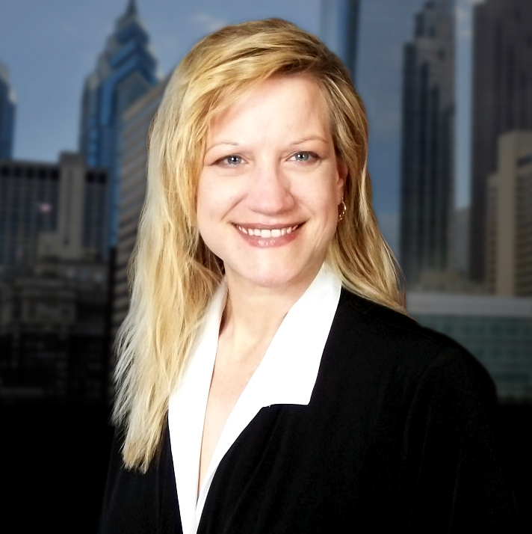
Welcome and Introductions
Keith Puliafico
Senior Director,
Talent & Development
Interim POC - LatAM
(AMER-DC)
Emily Finch
Manager,
Talent & Development
Manager Capability
(London)
Grace Seng
Senior Learning & Development
Manager - APAC
(Singapore)
Abigail Mirarchi
Senior Talent & Development
Analyst - Instructional Designer
(AMER-PA)
Notes:
EMILY
Hello and welcome everyone for joining us!
My name is Emily Finch and I am your host for today’s focus group.
I am glad to have an opportunity to meet all of you. Let me start with some brief introductions before we begin today.
I have been working for Thomson Reuters for 9 years. Some of my more notable roles include working for the Technology Operations based in London, the Sales organization as a Project Manager and then overseeing the HR Sales Graduate Program. For the last three years I have been leading the Management Capability domain area of Learning. Our current management audience spans over 7,632 leaders. Our MaTR program touches 5, 211 and 2,421 for our AMaTR audience.
We are also joined by Abigail Mirarchi. Abigail is our facilitator.
------------------------------
Abigail
Thank you Emily. Welcome everyone.
I am the Senior Talent & Development Analyst for learning. I am primarily responsible for all aspect of learning support. I analyze training programs and offerings, partner to create learning courses and resources and assist in delivering learning products that are fit for purpose. I will also be guiding today’s discussion.
Before we get started, let me also familiarize you with a few other people on our team. Keith Pulicafico, is our Senior Director of Talent and Development and Grace Seng, Senior Manager partner for our APAC region.
From everyone from Talent and Development, thank you for attending todays focus group.
Phone lines are, and will remain, open. If you anticipate background noise, please mute your microphone.

Slide 3
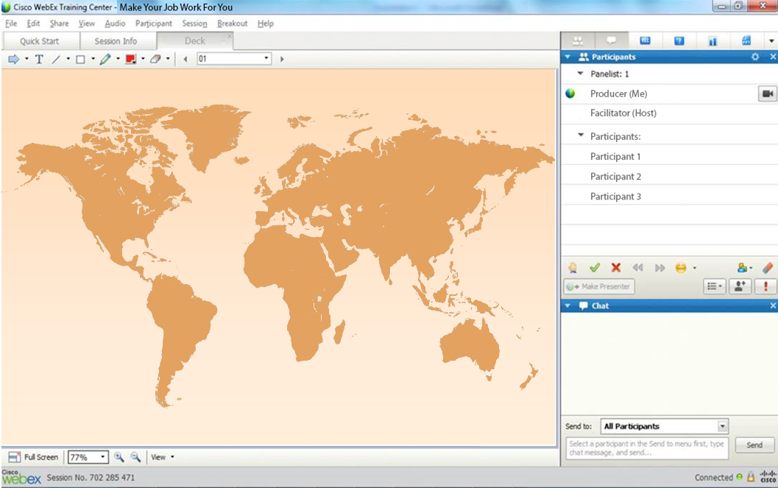
WebEx Environment Reminders
Notes:
SAY
Our focus group has been scheduled for approximately 90-minutes. If you are unable to stay with us the entire time due to prior commitments, we completely understand. Please accept our deepest gratitude for your participation ahead of time.
SAY
Okay, now it is our time to get to know you a little more, while we review a few tools we will use today. The Pointer, Green Check Mark/Red X and the Chat window.
Many of you may have already used these tools, however, for the benefit for everyone, let’s take a quick tour.
Starting at the upper Left hand corner of your WebEx window is the pointer tool, which is arrow pointing to the right.
ASK
Click on the pointer tool and then click on your location of where you are currently located.
SAY
Below the tool bar is the chat box. In the Chat Box, Where it says, Send to: keep the default to “All Participants”. During this focus group feel free to answer questions using this method.
ASK
In the chat window, type a brief introduction that includes your business unit and role at Thomson Reuters and how long you have been a manager at Thomson Reuters.
SAY
Above the Chat are two icons, a green check mark and red X.
ASK
Click the green check mark if you are comfortable using todays three tools.
Great! Thank you!

Slide 4
Introduction and History
MANAGEMENT AT THOMSON REUTERS (MaTR):
Enable first-line managers to drive employee engagement by focusing on fundamental people management skills.
ADVANCED MaTR (AMaTR):
Understand expectations of TR leaders and develop business / strategic acumen capabilities and skills to execute our strategy while building high performing teams.
Notes:
SAY
As you may know, Thomson Reuters invests in Manager Capability provides skills and leadership techniques through various tools and resources that align with Thomson Reuter’s values.
Our flagship programs for Manager Capability are MaTR & AMaTR programs.
These are exciting times where we have successfully established the foundations in both our MaTR and AMaTR programs.
Let me provide you a little history of our Management Capability Programs
We launched our global management capability programs, Management at Thomson Reuters (MaTR) in 2013 and Advanced Management at Thomson Reuters (AMaTR) 2014.
These programs have reached more than 9,000 leaders to-date.
The investment has increased productivity and manager effectiveness where by:
MaTR participation is positively correlated with both higher Manager Effectiveness Survey results for participants and higher Employee Engagement scores amongst direct reports of participants.
MaTR program Return on Investment (ROI) is conservatively estimated at 43%. (That is, for every $1 spent, $1.43 is returned to Thomson Reuters).
Among AMaTR participants, 98% applied what they learned and 68% reported significantly or worthwhile results for their unit (such as, increased revenues and cost savings).
AMaTR has resulted in a 148% Return on Investment (ROI) (where by, for every $1 spent, $2.48 is returned to Thomson Reuters).

Slide 5


Purpose and Strategy Overview
“With your support,
today’s conversation will allow us valuable insight on the leader learning journey.
With your partnership,
our goal is to continually provide tools and resources to help address the needs of our global front line managers and leaders.
Notes:
SAY
As part of our 2017 strategy our goal is to validate our current offerings are fit for purpose, while identifying emerging areas in both MaTR and AMaTR programs. We will focus on what needs to be developed, maintained, and enhanced to lead high performing global teams into 2018 and beyond.
When our Manager Capability Needs Analysis is complete, we will make recommendations for sustainable cost effective solutions to address gaps and opportunities for the areas that will have the largest influence on business performance.
We are grateful for your time with us today.
We will cover common themes and ask you questions about your observations, needs, and recommendations of the programs.
With your support, today’s conversation will allow us valuable insight on the leader learning journey.
With your partnership, our goal is to continually provide tools and resources to help address the needs of our global front line managers and leaders.
SAY
In order to ensure we are able to capture your feedback, ideas, suggestions and recommendations accurately, we would like to record this focus group. The recording, content and all discussions will be held in the strictest of confidence and will only be used to capture the information we need to make the appropriate recommendations and enhancements to the programs.
Do I have your support in recording today’s session?
ASK
Use the green check mark for yes, and the red x for no.

Slide 6

Share a little about your experience transitioning from Thomson Reuters individual contributor to a people manager role.
What specific skills or resources did you find necessary for your transition?
Notes:
Animation
SAY
Share a little about your experience transitioning from Thomson Reuters individual contributor to a people manager role.
ASK
Yes (Green Check Mark) transitioned internally
SAY
For the Green Check Marks – those that transitioned internally, this first set of questions will be for you to answer.
ASK
Type your first initial responses into the Chat window.
What specific skills or resources did you find necessary for your transition?
Which skill areas / learning content was not provided that you were expecting, or needed for your role?
Who did you contact or where did you obtain support to your needs?
No (Red X) Joined as a TR Manager
For the Red X – those that joined the TR organization as a manager, this set of questions will be for you to answer.
ASK
Type your first initial responses into the Chat window.
What specific skills or resources did you find necessary when you joined?
Which skill areas / learning content was not provided that you were expecting, or needed for your role?
Who did you contact or where did you obtain support to your needs?
ASK
Are there any additional responses?

Slide 7
Think about where you find answers to the following topics.
While managing my team, I use resources from the following place(s) to help me with:
Recruitment
Managing time off requests
Performance management (goal setting and achievement)
Employee ad-hoc inquiries
Building a diverse and inclusive team environment
Methods to provide feedback to my employees
Coaching my employees
Providing career development conversations
Communicating and modeling an enterprise mindset
Notes:
Animation
SAY
Think about where you find answers to the following topics.
I will present 9 topics, one at a time. Be as specific as possible where you find, locate, or who you go to for the your resources.
ASK
While managing my team, I use resources from the following place(s) to help me with:
Type your first initial responses into the Chat window.
Recruitment
Managing time off requests
Performance management (goal setting and achievement)
Employee ad-hoc inquiries
Building a diverse and inclusive team environment
Methods to provide feedback to my employees
Coaching my employees
Providing career development conversations
Communicating and modeling an enterprise mindset
Probing questions:
Which top 2 have been the most challenging to find or locate learning and resources?
Type your first initial responses into the Chat window.
*ASK
Are there any additional responses?

Slide 8
Think about questions you may have regarding the following topics.
What specific learning and support resources would be most beneficial to help assist you effectively perform the following:
How to accurately formulate, analyze and interpret required financial reports. (e.g. profit and loss statements, profit margins, balance sheets and budgets)
Make relevant business decisions by thinking commercially to achieve desired business outcomes. (e.g. risk/cost allocation, developing strategic plans, building partnering relationships, writing business proposals and requesting appropriate expertise)
Notes:
Animation
SAY
Think about questions you may have regarding the following topics.
I will present 3 topics, one at a time. Unlike the last question about resources that you use. Here, we want to know what learning and support resources would be most beneficial to help you. Be as specific as possible.
ASK
What specific learning and support resources would be most beneficial to help assist you effectively perform the following:
Type your responses into the Chat window.
How to accurately formulate, analyze and interpret required financial reports.
Examples could include but not limited to: profit and loss statements, profit margins, balance sheets and budgets.
2. Make relevant business decisions by thinking commercially to achieve desired business outcomes.
Examples could include but not limited to: risk/cost allocation, developing strategic plans, building partnering relationships, writing business proposals and requesting appropriate expertise.
(Optional depending on time)
3. Develop and execute a strategic vision across various levels of the organization.
4. Discuss and support the enterprise growth strategy to increase the customer experience.
*ASK
Are there any additional responses?

Slide 9
The current MaTR Summit is offered two ways: One Day (Face to Face) or 1.5 days (Virtual). The summit includes 2 Skill Sessions: Courageous Conversations & Your Impact on Others
Considering the additional Skill Sessions listed below for a MaTR which three do you feel are most valuable to have managers complete first and why?
MaTR = One Day (Face to Face) or 1.5 days (Virtual)
Includes 2 Skill Sessions: Courageous Conversations & Your Impact on Others
10 additional Skill Management Sessions available:
Beyond Unconscious Bias
Building Virtual Teams
Career Conversations
Coaching for performance
Differentiating performance
Dynamic Delegation
Frequent Feedback
Goal Setting
Innovate
Leading Change
Notes:
SAY
The current MaTR Summit is offered two ways: One Day (Face to Face) or 1.5 days (Virtual). The summit includes 2 Skill Sessions: Courageous Conversations & Your Impact on Others
ASK
Considering the additional Skill Sessions listed below for a MaTR which three do you feel are most valuable to have managers complete first and why? Please note, we are not removing any of the ten skill sessions listed, we simply want to know your impressions of which are the most valuable to complete first.
Please enter your number answers in the Chat window.
Probing questions:
What skill topic isn’t provided that you would expect to see or observed that should be included? And Why?
In your opinion, do you think a senior manager should have access to the content and skill sessions that are available in the MaTR program? (YES/NO)
Please enter your answer in the Chat window.
Why did you answer the way you did?
*ASK
Are there any additional responses?

Slide 10
Current MaTR Summit= One Day (Face to Face) or 1.5 days (Virtual)
Includes 2 Skill Sessions: Courageous Conversations & Your Impact on Others
Think about the length and content covered in the MaTR Summit. Which of the following would you suggest?
OPTION 1
Keep MaTR as it is today. No change.
OPTION 2
Lengthen the duration of the Summit and incorporate additional content with practical activities.
OPTION 3
Something else.
Notes:
SAY
Current MaTR Summit= One Day (Face to Face) or 1.5 days (Virtual) Includes 2 Skill Sessions: Courageous Conversations & Your Impact on Others
ASK
Think about the length and content covered in the MaTR Summit. Which of the following would you suggest and why?
Using your pointer tool select one of the following options:
OPTION 1: Keep MaTR as it is today. No change.
OPTION 2: Lengthen the duration of the Summit and incorporate additional content with practical activities.
OPTION 3: Something else?
Probing questions:
In your opinion, is it reasonable to request completion of pre and post summit activities for managers? Please enter your answer in the Chat window.
(Optional depending on time)
For Option 2 Responses: How much time would be appropriate? Two full days, Three full days, other? Please enter your answer in the Chat window.
In your experience, when would be the most appropriate time for a manager to take the MaTR Summit?
As soon as promoted
Within 30-90 days of being promoted
Other
*ASK
Are there any additional responses?

Slide 11
Thank You
Notes:
SAY
On behalf of Talent and Development, we are honored and grateful for your time and support today. It is with your partnership, observations, and recommendations for the programs that will allow us the ability to provide tools and resources that is most important to you. Your input is extremely important and to the enterprise success.
If you have any further questions about todays session or would like to provide Emily Finch additional observation or recommendations, please feel free to contact her directly.
Thank you and have a wonderful rest of the day!

