Slide 1


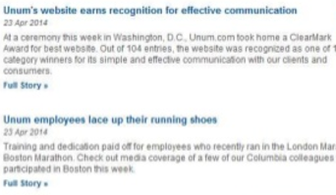
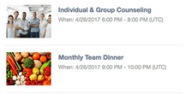
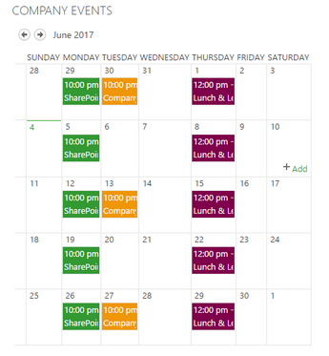


IDEA – A and/or IDEA B
Learning at Thomson Reuters
For All
IDEA
For All
Link to hub
For Facilitators
Want to attend a session? | Live Learning Calendar
Make Your Job Work For You
Be the CEO of Your Career 2.0
Link to docs
Catalog
About
2 folders each course
IDEA 1
Rather above
Face2Face (ILT) –
Webinar – (VILT) –
Make Your Job Work For You
Description
w/objectives
Delivery: (ILT/VILT)
Description w/objectives
Delivery: (ILT/VILT)
Make Your Job Work For You
Facilitator Materials
Description w/objectives
Delivery: (ILT/VILT)
Link to docs
Be the CEO of Your Career 2.0
Facilitator Materials
Face2Face (ILT) –
Webinar – (VILT) –
Be the CEO of Your Career
Description
w/objectives
Delivery: (ILT/VILT)
Course Name 3
Course Name 4
Course Name 3
Facilitator Materials
Face2Face (ILT) –
Webinar – (VILT) –
Course Name 3
Description
w/objectives
Delivery: (ILT/VILT)
Description w/objectives
Delivery: (ILT/VILT)
Description w/objectives
Delivery: (ILT/VILT)
Course Name 4
Facilitator Materials
Face2Face (ILT) –
Webinar – (VILT) –
Course Name 4
Description
w/objectives
Delivery: (ILT/VILT)
IDEA 2
IDEA
Upcoming Facilitator Meetings
T3 Training Calendar
IDEA
Link to doc/or Hub
Link to SCM & CC: ADM?
Link
Want to Facilitate? | Facilitator Requirements | Contact
For Facilitators
Want to attend a session? | Live Learning Calendar
Link to doc/or Hub
Link to SCM & CC: ADM?
IDEA 3
Discussion/Chat (?) TBD maybe link to hub?
Want to Facilitate? | Facilitator Requirements | Contact
For Facilitators
IDEA
Notes:
BACK END: LaTR Program Management
Career Development - Community Calls Calendar
Facilitator Requirements
What needs to be accomplished
Certification and Review Process
Xxxx

