Slide 1

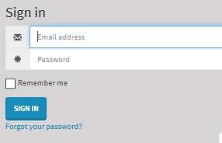
REVIEWMYeLEARNING APPLICATION:
https://www.reviewmyelearning.com/
Click (upper right corner) Sign In / Sign Up
Enter Sign In UN and PW and click SIGN IN
CURRENT INFO (Feb82017)
  UN: amirarchi@aim2train.com
  Pw: Iwant2grow2
CONTENTS
Add a Course
Delete a Course
Review while updating SL file
How to Review the elearning file (External Reference)

Slide 2
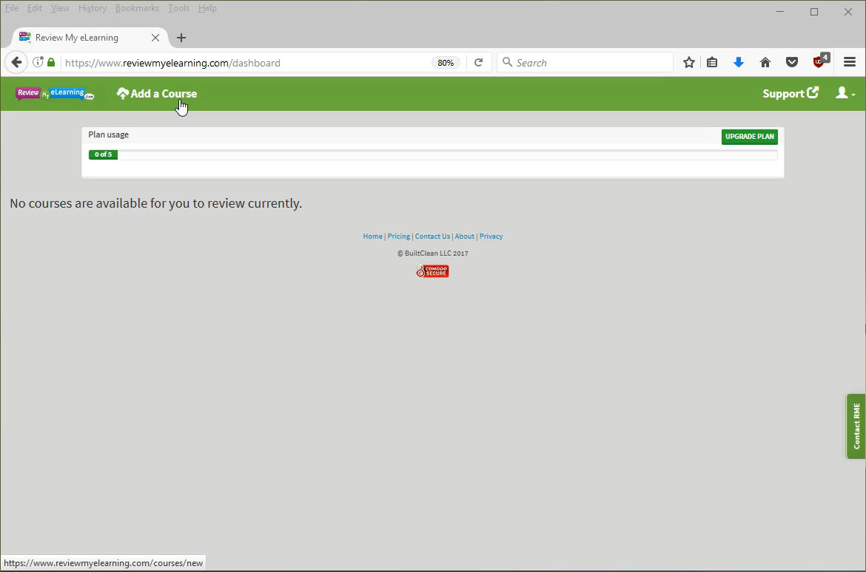
Add a Course
NOTE: No Audio
VIDEO STEP BY STEP
Hover over video to display video navigation.
Use player tools at bottom of video.

Slide 3
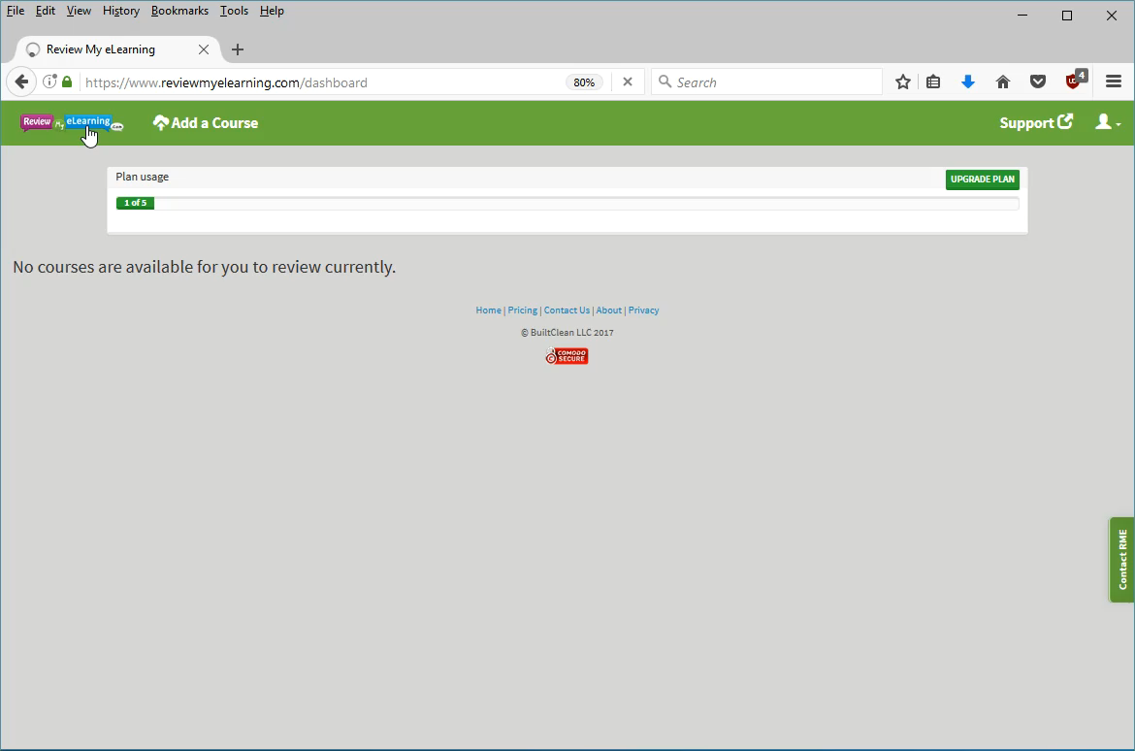
Delete a Course
NOTE: No Audio
VIDEO STEP BY STEP
Hover over video to display video navigation.
Use player tools at bottom of video.

Slide 4
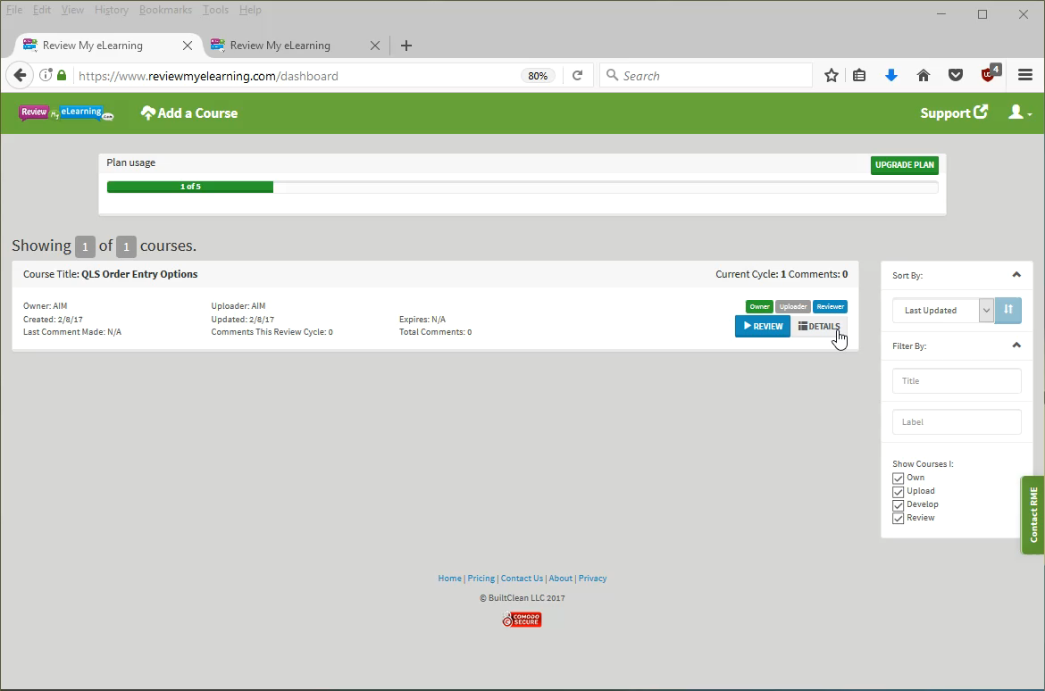
Review while updating SL file
NOTE: No Audio
VIDEO STEP BY STEP
Hover over video to display video navigation.
Use player tools at bottom of video.

Slide 5
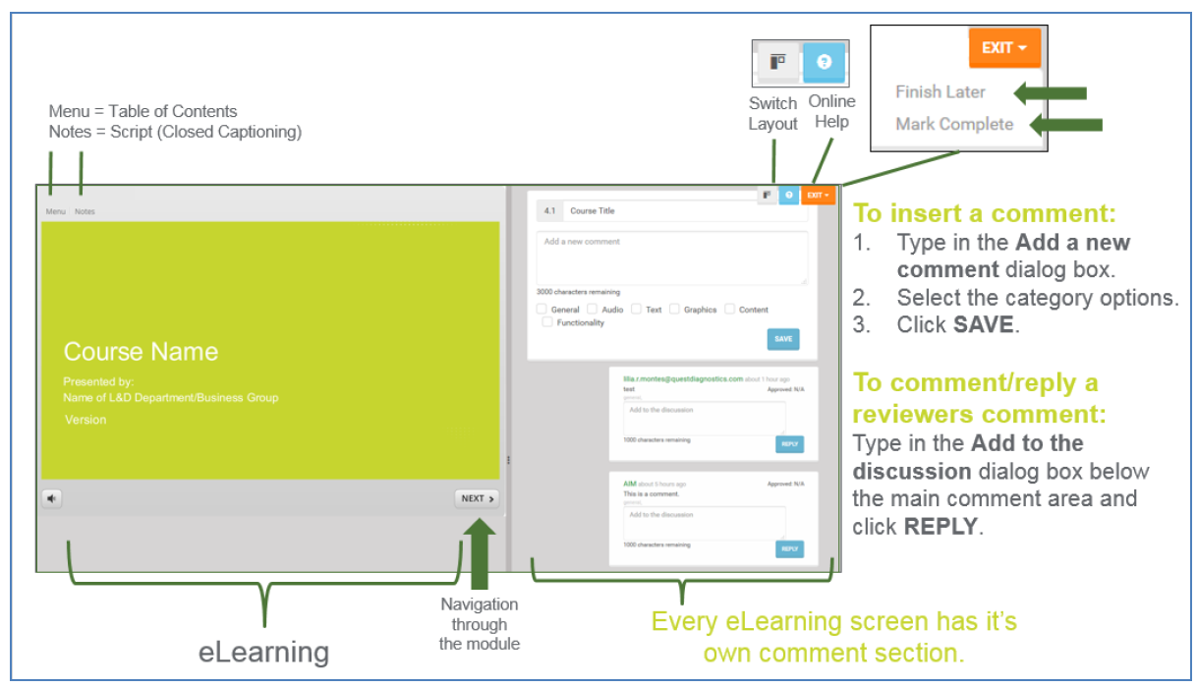
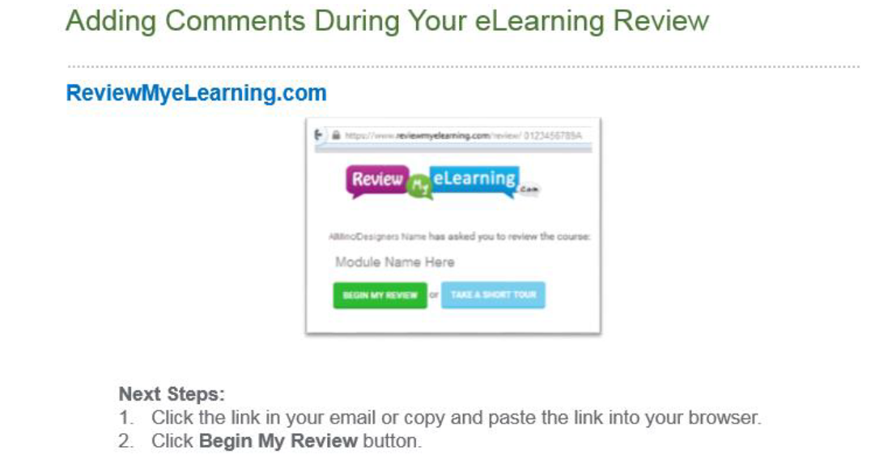
How to Review the elearning file (External Reference)

