Slide 1

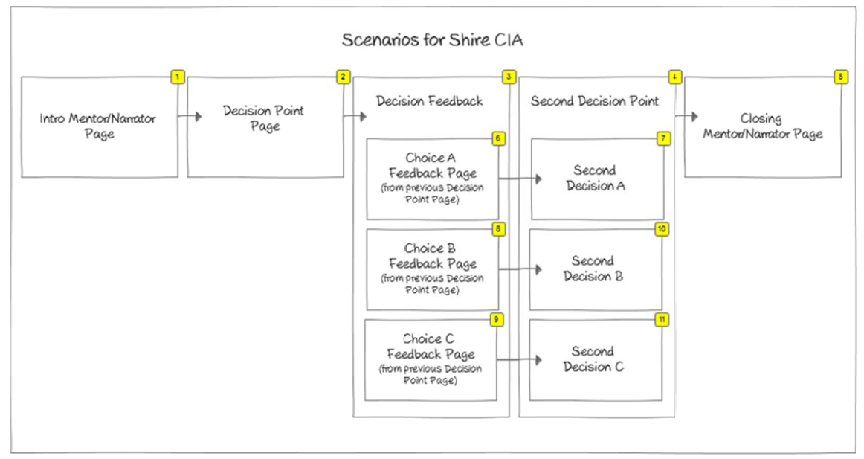
Look & Feel: Scenario Flow

