Slide 1

CIA Program Design Curriculum Roadmap
Master Design Strategy Document
Version 3.0
July 25, 2013
Performance Development Group | 610.854.4400 | performdev.com

Slide 2
Project Overview and Scope
PDG will work with Shire to design and develop a CIA e-learning curriculum that satisfies the CIA requirements and drives application of key behaviors across the organization. Work on this program will begin July 2013 with a target completion date of February 2014 to be in alignment with the anticipated CIA effective date of 1/2/14.
PDG will develop seven courses totaling ~11 hours of training:
  One General course: 30 minutes hour of training for all covered persons (to be supplemented by Shire’s existing 30 minute “Doing Business with Integrity” training)
  One Manager course: 30 minutes of training for all covered managers and supervisors (to be supplemented by Shire’s existing 30 minute “Doing Business with Integrity - Manager” training)
  Four Specific courses: 6 hours of training for relevant covered persons
    General: 90 minutes for all relevant covered persons
    R&D: 90 minutes for all relevant R&D covered persons
    Marketing/CommOps: 90 hour for all relevant Marketing/CommOps covered persons
    Sales: 90 minutes for all relevant Sales covered persons
  One External HCP course: 4 hours (Includes 210 minutes repurposed Specific content, 30 minutes of repurposed General content)

Slide 3
CIA Roadmap Background
Shire will enter into a Corporate Integrity Agreement (CIA) with an anticipated effective date of January 2, 2014 and will have 120 days to train full-time employees, contractors, and healthcare professionals and conduct internal CIA related activities.
Shire and PDG conducted an organizational assessment to determine the readiness of its current Compliance curriculum based on the anticipated CIA requirements
The Findings and Recommendations from the readiness assessment identified:
  Key themes
  Content areas for training
  High-level performance goals and learning objectives
  Training deliverables
Due to Shire’s recent restructuring, some policies and procedures will not be completed in time for inclusion in the training. Therefore, the Year 1 training will focus on guiding principles and values and the application of those principles.

Slide 4






Purpose and Agenda
The purpose of this document is to achieve a shared vision and common language around the following agenda items:
Goals
Approach
Content
Look & Feel
Tech Specs
Actions
Document Outcomes:
Audience Analysis
Performance Goals
Learning Objectives
Discuss Strategy:
Instructional
Strategies
Detail High Level:
Courses
Modules
Sample Deliverables:
Cover Page
Content Pages
Requirements For:
Hardware/
Software
Tracking, LMS
Gating,
Completion
Operational Needs:
Milestone Dates
Next Steps
Change Requests
Approval

Slide 5

Audience Analysis
Category | Response
Audience | Internal Facing – All CIA covered persons working at Shire or working on behalf of Shire. External Facing – All HCPs over the threshold (work more than 160 hours in a reporting period and/or over the current salary threshold).
Current Knowledge and Skill Level | Employees range from beginners who are new to the industry and/or profession to experienced performers who have many years of practice and expertise in their field.
Demographics | Employees represent a diversity of age, gender, and background. There are no special language or location concerns.
What’s in it for Learners (WIIFM)? | Employees’ behaviors are successfully modified and they are committed to conducting business in alignment with Shire compliance standards.
Environment | Employees will access the e-learning via the STELA LMS. Access to HCP course is to be determined (possibly STELA or a 3rd party hosted LMS)
What Change is Necessary? | Learners need to know the CIA requirements and Shire’s values and principles so that they can conduct all their activities with highest level of ethics and integrity.
Customization | No customization is required.
Expectations | The courses will satisfy the requirements of the CIA and drive application of key behaviors across the organization.

Slide 6
Instructional Strategies
These strategies demonstrate techniques used to accomplish the performance goals:
Strategy | Explanation
Contextualized Content | Contextualized content to help learners apply the knowledge and skills on the job.
Real-World Scenarios | Story-based scenarios where the learner will interact with a character or characters and make decisions reflecting an understanding of the material.
Engaging Learner Interactions | The following interactions will engage learners and allow them to learn by discovery: Matching (Drag and Drop): Learners click and drag a text item from one column to the matching text item in the other column. Multiple Choice: Learners select an option from a list to answer a question. Click and Reveal: Learners click a button or object to reveal a graphic that contains the content.
Primary Scenario
1st scenario immerses the learner in a piece of the storyline
Decision Point
The learner makes a decision about the scenario
Secondary Scenario
Based on response, the learner is presented with a 2nd scenario
Decision Point
The learner makes a decision about the scenario
Feedback & Reinforcement
The learner receives feedback on decision and value concepts are reinforced

Slide 7
Instructional Strategies
These strategies demonstrate techniques used to accomplish the performance goals:
Strategy | Explanation
Multiple Learning Channels | Learners are engaged through visual and audio channels including: Reading on-screen content presented in appropriate digestible “chunks” Hearing content through audio narration delivered by: Narrator Mentor Various characters representing Shire employees and healthcare professionals in realistic scenarios Viewing instructional graphics, graphic organizers, and animations that engage learners and illustrate relationships and key concepts
Mentor Character | On-screen mentor helps learners relate to the content, add interest, and helps convey: Key messages and why those messages are important Questions and points to consider Transitions between content chunks

Slide 8
Design Elements for Approval
Graphical User Interface (GUI)
The global elements for the course, such as buttons, header, footer, menu styles, and box treatments.
Animation
PDG will produce animations that enhance the learner experience by presenting content with timed to audio.
Audio
One audio narrator and one mentor character will be used in each course to support the course content. In Specific Sales, R&D, and CommOps, the characters in the scenarios will be narrated by different voices. 10 to 12 audio parts will be used across all courses.
Scenarios
Scenario characters will represent the diversity of Shire culture. Animated still images and distinct voices will add realism to these scenarios. Four to six scenarios will be presented in each of the following courses: Specific Sales, R&D, and CommOps. PDG will consult with SMEs to align scenarios to applicable content.
Graphics style
Character and location images will use photo realistic images to help immerse learners in the scenarios. Backgrounds/locations will leverage photo realistic images and will be “out of focus” to add interest and keep the learners attention centered on the person and the situation. The map image will be illustrated.

Slide 9
Curriculum Overview – Internal Facing
General
(PDG/Shire)
1 hour*
Specific - General (PDG)
90 Minutes
All
90 Minutes
All
Manager
(PDG/Shire)
All Covered Persons
Specific – Sales
(PDG)
Managers/ Supervisors
Specific – Marketing/Com Ops (PDG)
Specific – R&D
(PDG)
90 Minutes
90 Minutes
All
1 hour*
E-learning
E-learning
E-learning
E-learning
E-learning
E-learning
Reportable events
CIA and Its Requirements
Overview of Pharma Regs.
Topics
Patient Safety
IRO Transaction Review
Field Monitoring
New hires
Disciplinary actions
TOPICS
TOPICS
TOPICS
TOPICS
Product Promotion
Medical Information Inquiries
Engaging HCPs
Funding HCOs
Government and Payer Interactions
Social Media
TOPICS
Samples
Call Planning
Reprints
Speaker Programs
Interacting with MSLs
All BUs
DBWI* (30 Mins)
Publications
Engaging HCPs
Advisory Boards/Scientific Meetings
Investigator-Sponsored Trials
Roles and Responsibilities of MSLs
Roles and Responsibilities of HEOR/HEOR MSLs
Speaker Training
Speaker Programs
Engaging HCPs
Scientific Integrity
Advisory Boards
Incentive Compensation
Scenarios
DBWI* (30 mins)
Responsibility for coordinate with Covered Persons Champion
Samples
Incentive Compensation
Call Planning
Scenarios
Scenarios
Code of Ethics
*Will leverage the existing “Doing Business with Integrity” modules for the General Training and the Manager training

Slide 10
Curriculum Overview – External Facing
BoD
(Shire)
Live and then e-learning for new members
3 hours
All board members
TOPICS
General CIA Training Content (including DBWI) – 1 hour
Specific Training to Board – 2 hours
Board responsibilities under a CIA
Vendors
(Shire)
Code Certification only? Need to verify
HCP
(PDG)
E-learning
4 hours (develop 3 ½ more hrs)
HCPs over the threshold
TOPICS
Overview of CIA
Code of Ethics
Engaging HCPs (General)
Funding HCOs
Speaker Training (ComOps)
Advisory Boards(ComOps)
Speaker Programs\
Engaging HCPs (ComOps)
Engaging HCPs (R&D)
Advisory Boards/Scientific Meetings (R&D)
Investigator Sponsored Trials (R&D)
CSO *
(Shire)
E-learning
General CIA (same as Internal facing)
General Specific (same as internal facing – 90 mins)
Sales Specific (same as internal facing except for no incentive comp 90 mins)
Same topics as sales for the most part. May also need the Code.
Topics
Code of Ethics
Samples
Call Planning
Reprints
Speaker Programs
Interacting with MSLs
Scenarios

Slide 11
Goals & Objectives: General
Doing Business with Integrity: Building on Our Culture of Compliance
These are the performance goals and learning objectives agreed upon in the Curriculum Map:
Performance Goals | Learning Objectives
On the job, learners will: Comply with all CIA requirements Recall consequences for not complying with the CIA requirements | After completing this training, learners will be able to: Explain what a CIA is and why Shire has entered into the agreement Describe why complying with the CIA is important Describe the scope of Shire CIA requirements and recall the individuals to whom the CIA applies Identify the individuals who are responsible for certifying compliance with CIA requirements Discuss consequences for non-compliance with the CIA Differentiate what is a U.S. Government Reimbursed product as it relates to CIA

Slide 12
Goals & Objectives: General
Doing Business with Integrity: Building on Our Culture of Compliance
These are the performance goals and learning objectives agreed upon in the Curriculum Map:
Performance Goals | Learning Objectives
On the job, learners will: Fully comply with Shire BRAVE values in all activities Use the Code of Ethics to guide decision-making | After completing this training, learners will be able to: Identify Shire’s BRAVE values Describe how to use the Code of Ethics to help address ethical and legal issues and dilemmas
Recognize the key laws and guidelines governing the pharmaceutical industry Avoid situations that could lead to violations | Describe the importance of complying with pharmaceutical laws and regulations and industry codes and standards. Recognize potential compliance violations that may arise in your daily work
Report adverse events and product quality complaints | Identify product quality complaint sand reportable adverse events Describe the process for reporting adverse events and product quality complaints

Slide 13
Goals & Objectives: Specific General
Doing Business with Integrity: Products and Promotion
These are the performance goals and learning objectives agreed upon in the Curriculum Map:
Performance Goals | Learning Objectives
On the job, learners will: Recognize the principles for engaging in appropriate promotional activities that comply with federal health care laws and regulations Adhere to FDA guidelines and federal laws regarding product promotion and labeling during interactions with HCPs | After completing this training, learners will be able to: Identify the laws, regulations, and industry codes that govern the promotional practices associated with Shire products Recall risks associated with off-label activities as they relate to the promotion and sale of Shire products Describe how to use claims effectively and correctly Describe the CMLR (Commercial, Medical, Legal, Regulatory) review process Describe the appropriate use of promotional materials
Respond appropriately to inquiries about off-label use | Identify off-label inquiries Explain the appropriate guidelines for handling off-label questions Identify who can respond to off-label questions

Slide 14
Goals & Objectives: Specific General
Doing Business with Integrity: Products and Promotion
Performance Goals | Learning Objectives
On the job, learners will: Comply with the principles and laws governing engaging HCPs Discern business needs and document those needs before engaging with HCPs Recognize that Shire only engages HCPs for legitimate business needs, and that the HCPs are paid the value of their service and no more | After completing this training, learners will be able to: Define engaging HCPs and identify the laws (Including the Anti- Kickback Statute) that govern interactions with them Discuss the critical importance of the term “legitimate need” and why legitimate need must be identified and documented before an HCP is engaged and/or paid Explain fair market value and how it is determined by Shire Discuss Physician Aggregate Spend as it relates to state reporting laws and the Federal Physicians Payment Sunshine Law
Apply processes and standards for grant requests when faced with specific customer inquiries | Describe the guidelines for providing educational grants Describe the guidelines for providing charitable contributions
Engage in appropriate discussions with HCPs regarding prior authorization | Describe appropriate interactions with HCPs regarding prior authorization Describe the prior authorization process Explain the consequences for non-compliance with prior authorization guidelines
Use social media responsibly Adhere to the guidelines for using social media | Identify examples of social media Describe the guidelines for using social media

Slide 15
Goals & Objectives: Specific R&D
Doing Business with Integrity: Medical and Scientific Communications
These are the performance goals and learning objectives agreed upon in the Curriculum Map:
Performance Goals | Learning Objectives
On the job, learners will: Follow all applicable standards, regulatory requirements, and laws when performing scientific activities | After completing this training, learners will be able to: Describe the standards for ensuring scientific integrity
Adhere to the guidelines for scientific publications | Identify the guidelines related to scientific publications
Comply with the guidelines for specific consulting engagements with HCPs | Describe the guidelines for specific consulting arrangements with HCPs
Adhere to Shire standards when arranging advisory boards and scientific meetings | Describe the guidelines related to purpose, content, selection of participants, materials, and conduct of advisory board and scientific meetings Explain the guidelines for consultant agreements
Comply with standards for Shire Investigator-sponsored Trials | Describe the guidelines for guidance and oversight of Investigator-sponsored Trials

Slide 16
Goals & Objectives: Specific R&D
Doing Business with Integrity: Medical and Scientific Communications
Performance Goals | Learning Objectives
On the job, learners will: Recognize the appropriate interactions with Sales and Marketing and Key Opinion Leaders (KOLs) Identifying appropriate MSL presentations | After completing this training, learners will be able to: Identify the roles and responsibilities of MSLs, HEORs/HEOR MSLs Describe appropriate interactions between MSLs and sales representatives Describe MSL interactions with KOLs

Slide 17
Goals & Objectives: Specific Marketing/CommOps
Doing Business with Integrity: Product Promotion and Communication
Performance Goals | Learning Objectives
Adhere to Shire standards when conducting advisory boards | Describe the requirements for conducting advisory boards
Adhere to FDA and Shire standards for speaker training | Identify the FDA regulatory requirements for speaker training Describe the guidelines for speaker training at Shire
Adhere to FDA and Shire standards for speaker programs | Differentiate the requirements of Shire-sponsored speaker programs and CME presentations Describe the laws and regulation governing speaker programs Describe the guidelines for speaker training at Shire
Comply with the guidelines for specific consulting engagements with HCPs | Describe the guidelines for specific consulting arrangements with HCPs

Slide 18
Goals & Objectives: Specific Sales
Doing Business with Integrity: Promoting Our Products
These are the performance goals and learning objectives agreed upon in the Curriculum Map:
Performance Goals | Learning Objectives
On the job, learners will: Distribute samples appropriately | After completing this training, learners will be able to: Describe the PDMA governing the use of samples Explain the guidelines governing the distribution of samples
Implement call plans according to Shire guidelines | Describe how to identify the appropriate HCP
Use reprints appropriately | Discuss guidelines for use of reprints
Adhere to FDA and Shire policy standards for speaker programs | Differentiate the requirements of Shire-sponsored speaker programs and CME presentations Describe the laws and regulation governing speaker programs Describe the guidelines for speaker training at Shire
Recognize the appropriate interactions between Sales personnel and MSLs | Describe appropriate interactions between MSLs and Sales

Slide 19
Goals & Objectives: Specific Managers
Doing Business with Integrity: Managers and Supervisors
These are the performance goals and learning objectives agreed upon in the Curriculum Map:
Performance Goals | Learning Objectives
On the job, learners will: Ensure that employees who report to you are in compliance with the CIA requirements Ensure that new hires complete their training within the appropriate time period Be a resource for employees who have questions about CIAs | After completing this training, learners will be able to: Identify reportable events and process for reporting Explain your responsibility for certifying compliance with CIA requirements Describe your responsibilities under Field Monitoring Program Explain your responsibilities for performing IRO transaction reviews Identify types of disciplinary actions for non-compliance Explain responsibilities for coordinating with Covered Persons Champion

Slide 20
Goals & Objectives: HCPs
Doing Business with Integrity: Healthcare Professionals
Performance Goals | Learning Objectives
On the job, learners will: Comply with all CIA requirements Recall consequences for not complying with the CIA requirements | After completing this training, learners will be able to: Explain what a CIA is and why Shire has entered into the agreement Describe why complying with the CIA is important Describe the scope of Shire CIA requirements and recall the individuals to whom the CIA applies Identify the individuals who are responsible for certifying compliance with CIA requirements Discuss consequences for non-compliance with the CIA Differentiate what is a U.S. Government Reimbursed product as it relates to CIA
Fully comply with Shire BRAVE values in all activities Use the Code of Ethics to guide decision-making | Identify Shire’s BRAVE values Describe how to use the Code of Ethics to help address ethical and legal issues and dilemmas

Slide 21
Goals & Objectives: HCPs
Doing Business with Integrity: Healthcare Professionals
Performance Goals | Learning Objectives
On the job, learners will: Comply with the principles and laws governing engaging HCPs Recognize that Shire only engages HCPs for legitimate business needs, and that the HCPs are paid the value of their service and no more | After completing this training, learners will be able to: Define engaging HCPs and identify the laws (Including the Anti- Kickback Statute) that govern interactions with them Discuss the critical importance of the term “legitimate need” and why legitimate need must be identified and documented before an HCP is engaged and/or paid Explain fair market value and how it is determined by Shire Discuss Physician Aggregate Spend as it relates to state reporting laws and the Federal Physicians Payment Sunshine Law
Apply processes and standards for grant requests | Describe the guidelines for providing educational grants Describe the guidelines for providing charitable contributions

Slide 22
Goals & Objectives: HCPs
Doing Business with Integrity: Healthcare Professionals
Performance Goals | Learning Objectives
Adhere to Shire standards when conducting advisory boards | Describe the requirements for conducting advisory boards
Adhere to FDA and Shire standards for speaker training | Identify the FDA regulatory requirements for speaker training Describe the guidelines for speaker training at Shire
Adhere to FDA and Shire standards for speaker programs | Differentiate the requirements of Shire-sponsored speaker programs and CME presentations Describe the laws and regulation governing speaker programs Describe the guidelines for speaker training at Shire
Comply with the guidelines for specific consulting engagements with HCPs (CommOps and R&D) | Describe the guidelines for specific consulting arrangements with HCPs (CommOps and R&D)
Adhere to Shire standards when participating advisory boards and scientific meetings | Describe the guidelines related to purpose, content, selection of participants, materials, and conduct of advisory board and scientific meetings Explain the guidelines for consultant agreements
Comply with standards for Shire Investigator-sponsored Trials | Describe the guidelines for guidance and oversight of Investigator-sponsored Trials

Slide 23
Look & Feel: Course Colors
General
Manager
Specific – General
Specific – R&D
Specific – Sales
Specific – Marketing/CommOps
Each course will have a different color based on the Shire color palette.

Slide 24

Look & Feel: Start Screen General Course
Opening screen displayed when course starts.

Slide 25

Look & Feel: Welcome Screen General Course
Welcome screen displayed after users click the Start button on the opening screen.
Notes:
Removing iPad instructions.
From Tracy - 7/25: My only concern about the onscreen instructions is that until STELA is able to support ipad usage we are trying not to encourage users to access STELA via their ipad. I wonder if this will prompt more users to try to access via their ipad? I understand why you put the instructions there to “future proof”. Would ipad savvy people know that viewing in landscape is ideal?

Slide 26
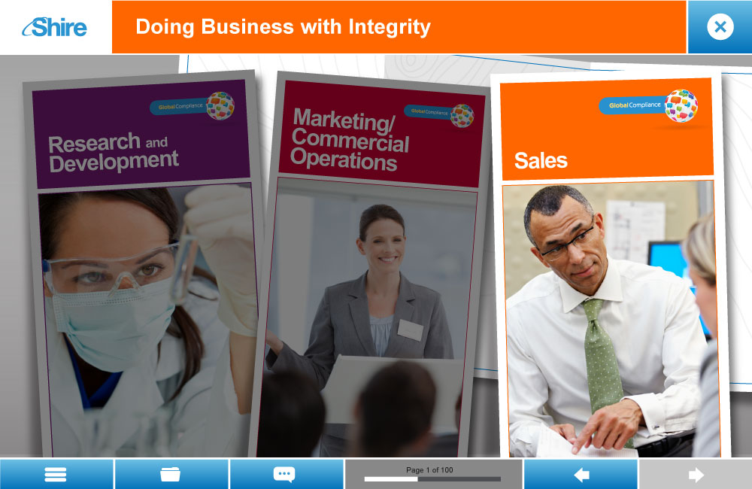
Look & Feel: Start Page Role-Specific Course
Launch page where learners start their role-specific training. “Map” for role will be highlighted. Other maps will be dimmed.

Slide 27
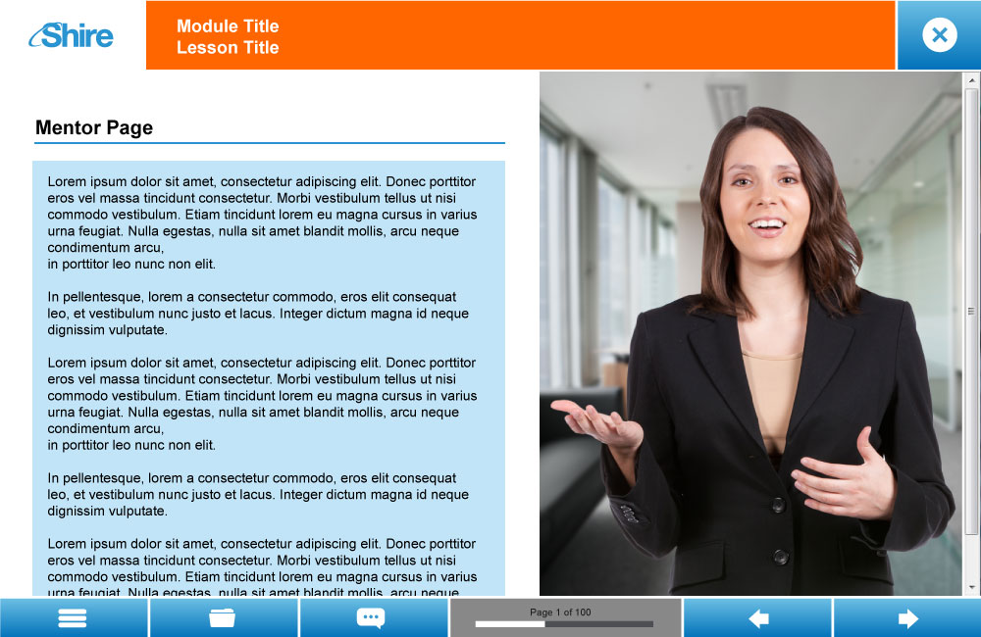
Look & Feel: Mentor
Each course has its own mentor to help learners relate to the content.

Slide 28
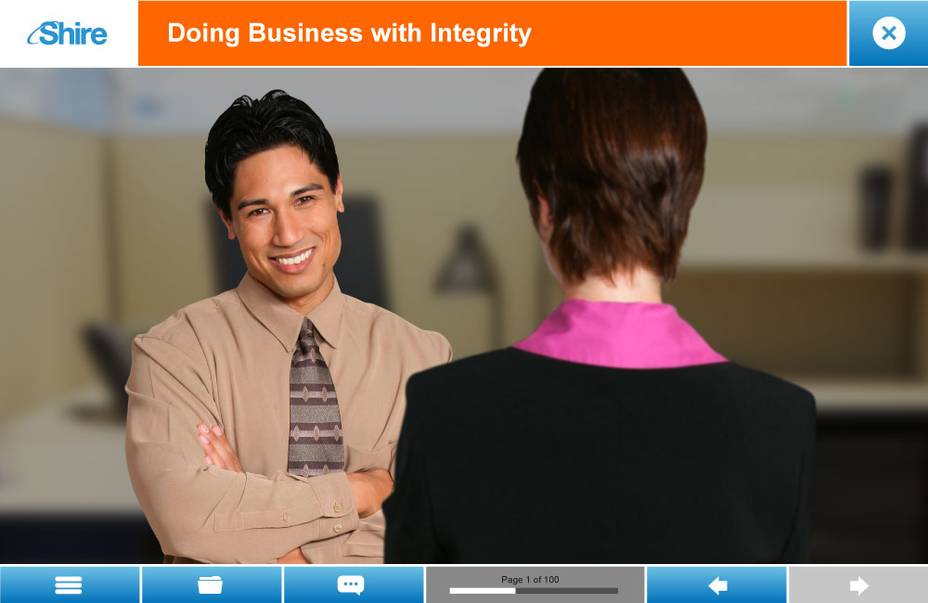
Look & Feel : Scenario
Scenario featuring one or more characters with out of focus background treatment to be used in the scenarios with or w/out slight movement between the foreground and background. Animated scenarios will appear in a video window.

Slide 29
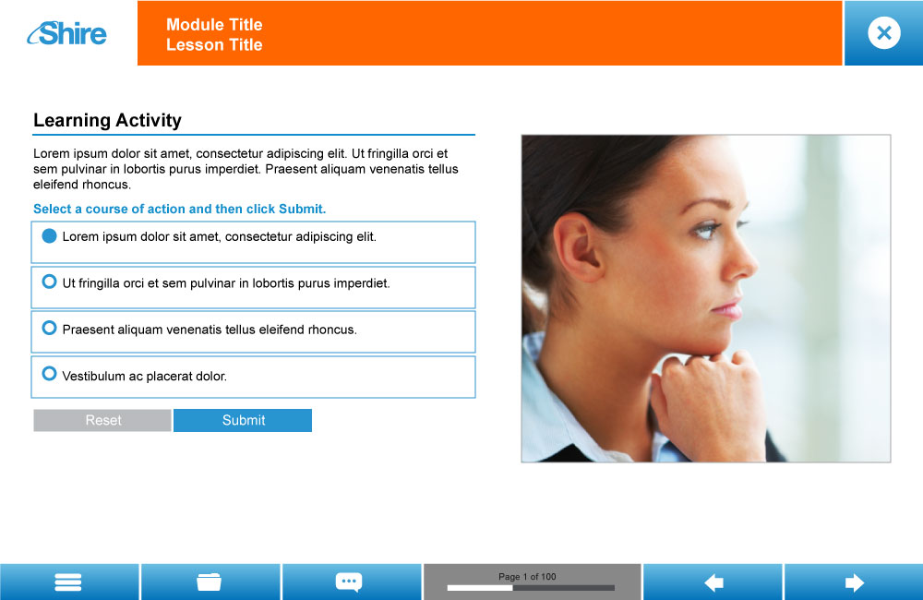
Look & Feel: Learning Activity
After user clicks the Submit button, feedback content revealed in box, replacing image.

Slide 30
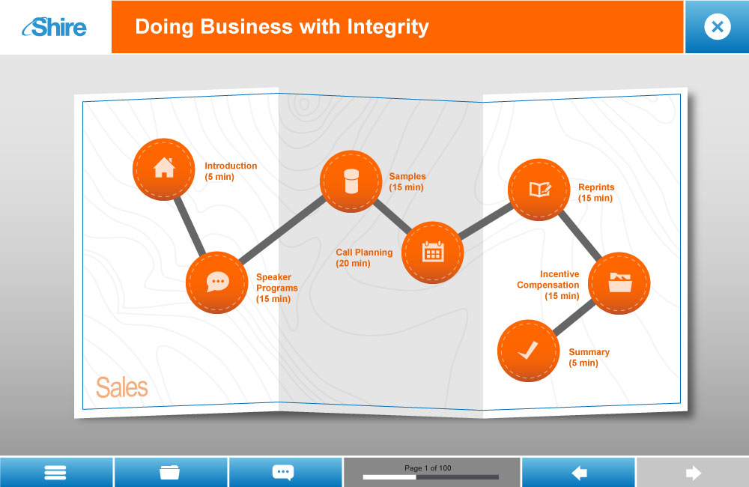

Look & Feel: Course Map
This graphic shows a of a typical layout of the modules for a course. Audio at the start of each module would include the module timing to help the learner plan their time. Pushpin indicates the current module learner is taking to act as a “you are here” on the map.

Slide 31










Look & Feel: Characters
Proposed images for the mentors and scenario characters. Characters will represent a variety of positions throughout the company. PDG and Shire will collaborate to create character profiles.

Slide 32


Look & Feel: Character Types - Stills
Still character images may be animated in scenarios or as stand alone, multiple stills may be used in a scene to simulate interaction without shooting video.

Slide 33

Look & Feel: Character Introductions
Mentor and characters will be introduced at the beginning of each course so the learner “knows” who they are interacting with in the course.

Slide 34
Look & Feel: Character Introductions
Character introductions will include the name and role of the character.
Arianna Perez
Sales Representative
Roslyn Jones
R&D
Dr. Albert Nguyen
Neurologist

Slide 35

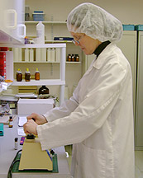
Look & Feel – Stock Photography
Stock image photography may be used where appropriate to support the content presented through audio and on-screen text.

Slide 36
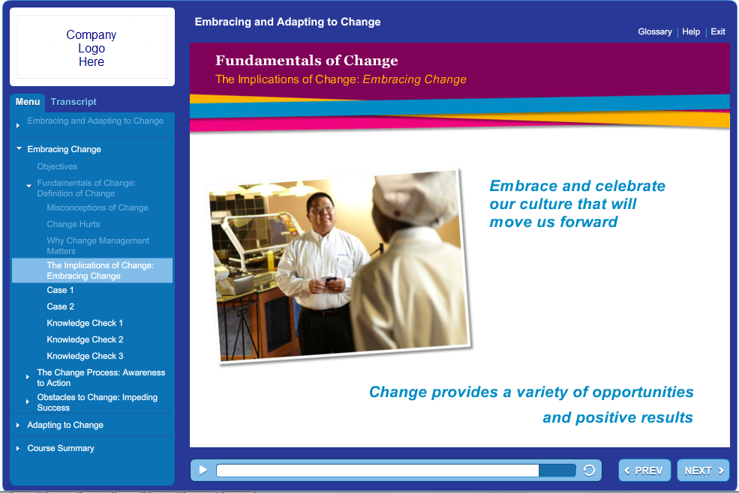
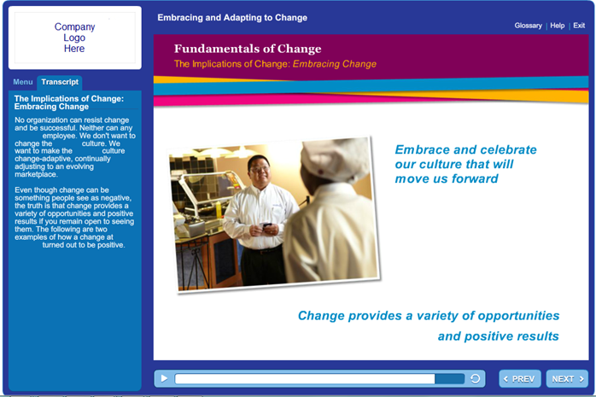
Look & Feel: Sample GUI – HCP Course
These are examples of what the content and transcript pages might look like for the HCP course in Storyline.

Slide 37
Technical Requirements
Element | Description
Audience Specifications | Hardware: PCs / Laptops, iPad Operating Systems: Windows XP and 7 (32 bit and 64 bit), iOS 6 Browsers: IE 8 & 9 on PC Safari 6 on iPad Flash Player: 10+ Adobe Reader: 7+ Resolution: 1024x768 minimum Bandwidth: LAN / Ethernet Broadband VPN access
Course Specifications | Technologies used to Develop course: HTML, JavaScript, CSS, Flash Media File Types: Graphic: JPEG, PNG Audio: MP3 Animation: MP4 Documents: PDF Resolution: 1000x650

Slide 38
Technical Requirements, Continued
Element | Description
Course Specifications, Continued | Gating: Gated - Learner must complete each screen in order to advance Bookmarking: When returning to the course, learners will be given the option to return to the last page viewed or start at the beginning. Completion: Course will report completion to the LMS once the learner has : Reached the end of the course after completing all pages
LMS Specifications | LMS: STELA (Saba 5.1) Communication Standard: SCORM 1.2 Hosting: 3rd Party (Saba) Administration: Kelli Risch File Size Limitations: None The MIME types for the follow file types have been set on the server delivering the course assets: Video – mp4, Audio – mp3 Bandwidth shared by all connected users: TBD by Shire’s Saba service level agreement. Though, it is understood that their LMS at least has a dedicated server and internet connectivity. Further evaluation will be conducted to ensure the LMS can adequately support the user audience. PDG Access (for testing purposes): Testing / Staging: No – Must work with Shire representative for testing courses on LMS Production: No
Notes:
From Karen: In order to get video and audio to work on Saba LMS, we are using JWPlayer. With JWPlayer, on the iPad, the user can tap the video and see a scrub bar, which will allow them to scrub to the end of the video without watching it. This feature of the current JWPlayer cannot be turned off.

Slide 39
Technical Requirements, Continued
Element | Description
LMS Tracking | Completion Status: Incomplete / Completed Score: No Bookmarking Data: Yes
Testing Process | PDG will work with Shire’s representative to coordinate and perform testing of the following: A generic, fully-functioning prototype (Working Model). The Working Model will be created following approval of this document Beta and Gold versions of the course PDG will test the course on: All previously defined user environments PDG’s LMS environments Any Testing and Production environments to which Shire grants PDG access Shire will test the course on: All previously defined user environments Shire’s STELA LMS Testing environment

Slide 40

PDG Courseware Development Process
Alpha
Project Initiation
Design
Alpha/Beta
Gold
Initiation
Still
Graphics
Common Design
Finalize
Audio/Visual
Audio
Screen Types
Storyboard
Animation
Alpha/Beta
Programming
Finalize
Programming
Test
Test
Initial LMS Integration Testing
Final LMS Integration Testing
Closeout
July
August
September
October
November
December
January
Client
Input
Client
Sign-off
PM
ID
MS
Dev

Slide 41
Milestone Review Dates
Current SOW
Change Request
Next SOW
CIA
Effective Date 1/2/14
CIA
Revise
6/12/13
7/26/13
~7/29 – 10/6
~10/7 – 12/29
1/10 – 1/23
1/24 – 2/6
Curriculum Map
  Breakdown of learning by CIA covered audience
  High-level performance goals and topics
Master DSD
  Learning strategy
  Characters
  Backgrounds
  Branding
  Goals and objectives by course
Storyboard
  Production-ready
Gold
Testing
Alpha/Beta
CIA
Launch
~2/7
~10 weeks
~12 weeks
~ 1 week
~ 2 weeks
~ 2 weeks

Slide 42
Milestone Review Dates
These review dates reflect Shire review only. PDG will provide a detailed project plan that covers all dates for each deliverable.
Deliverable | Description | Review timeframe
 |  | General and Manager | Specific General | Manager
Master Design Document | Program goals and objectives Design strategy Functional and technical specs | 7/25-7/26
Storyboard Document | Complete program, including content, graphics descriptions and programming notes | TBD | TBD | TBD
Alpha/Beta Program | Full working version with graphics, professional audio, and animations Includes still frame photos | TBD | TBD | TBD
Gold Program | Deliver approx 8 days prior to release to learners | TBD
Notes:
6

Slide 43
Next Steps
These review dates reflect Shire review only. PDG will provide a detailed project plan that covers all dates for each deliverable.
Who | What | When
Shire | Review and Approve MDSD | 7/25 – 7/26
Shire | Block key review dates on calendars
Shire | Provide list of SMEs for scenarios (for ID to meet with)
PDG | Begin Storyboard writing | 7/29
PDG | Deliver Storyboards to Shire for review

Slide 44
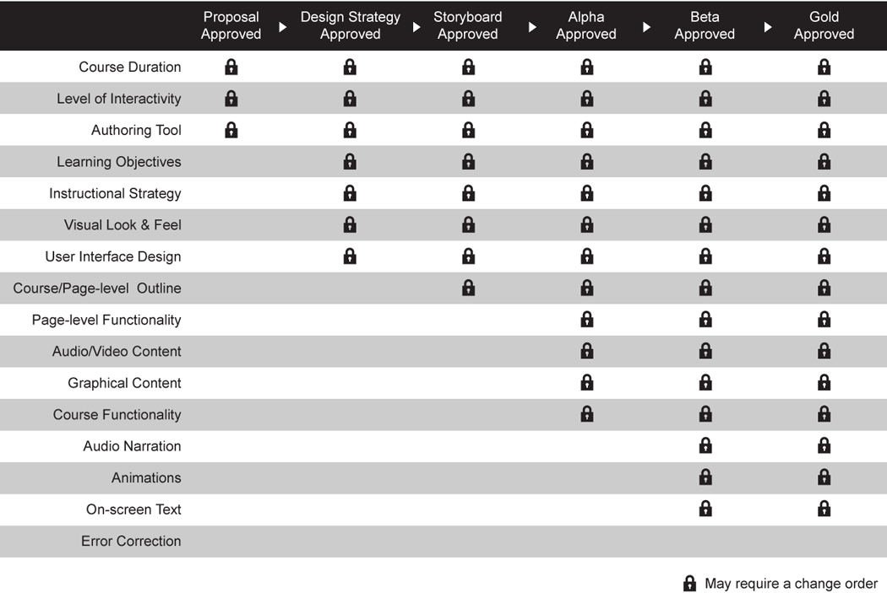
Scope Lockdown Process

Slide 45
Change Request Process
PDG asks that Shire reviewers carefully study project documents, provide feedback, and sign off on the final versions of documents.
  Once Shire approves a particular document in the development process, PDG begins work on the next.
  If Shire later requests changes that deviate from or exceed the specifications in this Design Strategy Document or later content documents, PDG will initiate a change order process using the approach shown below.
PDG understands that clients sometimes request changes even after approving design or content documents.
  In an effort to accommodate our clients and deliver the highest quality product, PDG will consider changes during development, provided the necessary time and resources are available.
  Please note that it is important to request any changes as early in the development process as possible to keep the expected cost and disruption to the project schedule to a minimum.

Slide 46
Change Request Process
Each change request that PDG can accommodate will initiate our change order process:
The Shire Project Lead requests a change verbally or in written form from the PDG Project Manager.
The PDG Project Lead consults with the team and determines the feasibility of the proposed change.
For feasible changes, the PDG Project Lead completes a Change Order Form and sends it to Shire for approval. The Change Order Form will specify the change’s impact on scope, schedule, and/or cost.
Change work begins when Shire returns the Change Order Form to PDG, indicating approval of the outlined specifications.

Slide 47
Approval
Element | Description | Approval
Goals | The performance goals and learning objectives accurately define expected course outcomes.
Approach | The instructional approach is appropriate to achieve the specified goals.
Content | The content outlined adequately addresses the scope of information required to meet course objectives.
Look and Feel | The look and feel mock-ups of the interface are appropriate for the content and audience.
Technical Requirements | The technical requirements are accurate and complete.
X
X
X
X
X
___________________________________________
Tracy Hickey, Shire Project Lead

Slide 48
Thank You

