Slide 1

CIA Program Design Curriculum Roadmap
Findings & Recommendations and Curriculum Map
Revised & Submitted June 17, 2013
Performance Development Group | 610.854.4400 | performdev.com

Slide 2
Agenda
Project Goals
Focus Group Goals
Key Themes
Findings & Recommendations
Proposed Curriculum Map
Next Steps
Detailed Analysis Results

Slide 3
Project Goals
Initiative Goal:
Shire engaged PDG to assess the readiness of its current Compliance curriculum in anticipation of a potential Corporate Integrity Agreement (CIA). And then, develop a comprehensive curriculum that both satisfies those requirements and drives application of key behaviors across the organization.
  From Shire Readiness Overview:
  Since September 2009, Shire has been cooperating with the United States Attorney’s Office for the Eastern District of Pennsylvania on an investigation related to allegations of improper sales and marketing practices in the Company’s Specialty Pharmaceuticals business.
  The scope of any potential CIA is not known. Readiness is being assessed across all Shire US business units (RM, HGT,GI, Neuroscience, Internal Medicine, and Corp).
  Shire employees involved in promotional and product related functions may become “Covered Persons”. This includes Sales and marketing. R&D and Corporate functions may also be impacted.
  Based on conversations with Shire Leadership and the Readiness Overview, PDG understands the focus of the CIA may be on R&D and Sales & Marketing and aligned data collection efforts in these areas.

Slide 4
Focus Group Goals
Our analysis sought to answer these questions:
What past experiences with CIA training & communication can be leveraged?
What audience specific compliance challenges exist and how have they been addressed?
What are the expectations of CIA training at Shire?
What are the e-learning preferences at Shire?
What are the desired performance goals upon completion of the CIA training?

Slide 5
7 Key Themes
Data collected from the focus groups addressed many areas; our analysis identified the following 7 key themes:
CIA Curriculum
Culture
(49)
Training
(38)
CIA
(14)
Compliance Dept.
(11)
Key Behaviors
(10)
Leadership
(13)
Scenario
(30)
The culture of Shire; Use of culture at Shire
Business needs; What people should be doing every day
Training at Shire; Expectations of CIA training; Thoughts about e-learning
Views about the Shire Compliance Department; Compliance as a partner and resource
Possible scenarios for CIA training; Importance of scenario-based training
Role of leadership for CIA training; Accountability
CIA background; Impact of this CIA; Communication
Slide updated 6/19/13
Notes:
Culture – Shire is big on culture. CIA is an opportunity to enable culture of compliance. Shire tends to be reactive rather than proactive
Training – Provide right amount of training to the right people. Incorporate compliance messaging, hold people accountable
Scenario – Using relevant scenarios. Show impact of employees behavior on different stakeholders
CIA – Discuss importance of ongoing monitoring, manage the initial negative perceptions.
Leadership – Leadership buy-in and support, leaders held accountable
Compliance – Most people see compliance as a partner/coach; being compliance is good business practice
Key Behaviors – Be brave and speak-up, be proactive and do it right the first time, do what is right for the business while being compliant, managers should be a credible resource

Slide 6
Build a Culture of Compliance
Culture
(49)
The culture of Shire, Use of culture at Shire
Findings
Recommendations
Shire is big on culture
The CIA is viewed as a “major culture shock” to Shire
The CIA is an opportunity to enable a culture of compliance
Shire tends to be reactive rather than proactive
Incorporate “One Shire” concept into training
Leverage Shire’s positive view of “culture” in the training:
  Frame CIA as a way to reinforce culture of compliance (characters, scenarios)
  Include the “doing business with integrity” value throughout training
  Depict the Shire culture in the Master Design Document (backgrounds, characters, big bold, colorful)
“
Weave compliant messaging and guidance into the training. The CIA training is a step to take it further so it's part of the culture and not standalone training.
”

Slide 7
Increase Effectiveness of Training
Training
(38)
Training at Shire; Expectations of CIA training; Thoughts about e-learning
Findings
Recommendations
Provide the right amount of training to the right people
Incorporate compliance messaging into training
Hold people accountable
Demonstrate what success looks like
Use knowledge checks throughout the training rather than assessments
Create CIA learning roadmap
Set expectations - Clearly communicate early and often who will take what training
Incorporate scenario-based knowledge checks
Do not use end-of-course assessments
Focus on values and principles rather than processes and procedures for Year 1 training
“
”
Create content in a way that it can be re-used so they can use it for reinforcement.

Slide 8
Create Scenario- Based Training
Possible scenarios for CIA training; Importance of Scenario-Based Training
Scenario
(30)
Findings
Recommendations
If you do business the right way, it will be a competitive advantage
Tie compliance activities to the impact of our interactions with HCPs
Use emotions i.e. “Brave Awards”
Scenarios need to be realistic and relevant to all audiences; and should show consequences
Show the impact of employee’s behavior on different stakeholders
Focus of training should be on application – how does this apply to me?
Identify a cast of characters & locations that resonate well with all audiences
Make scenarios HCP and patient-focused
Weave several scenarios through out training that demonstrate the impact of employee behavior on stakeholders
Demonstrate how being proactive will benefit HCPs and our patients
“
Most effective trainings are interactive. Using real-life scenarios that people can apply to their every day activities is most effective.
”

Slide 9
Articulate Meaning of CIA
CIA
(14)
CIA background; Impact of this CIA; Communication
Findings
Recommendations
What is it – how did we get here?
Need to discuss the importance of ongoing monitoring
Need clarification about what has to be done, by whom, and by when
Manage the initial negative perceptions
Provide a CIA Overview in the General Training
Develop a communication plan that includes messages, audience, frequency, methods to ensure all employees are informed
Messages should be delivered from the top down from business unit leaders in order to increase employee buy-in (risk: interim business leaders in place today may change by the time training is rolled out)
Communicate how the training fits into the requirement of the CIA
“
”
They think it's not major because the fine is small. Some people are in denial.

Slide 10
Identify Leadership Role
Leadership
(13)
Role of leadership for CIA training; Accountability
Findings
Recommendations
Employees want to see leadership buy-in/support
Leaders should be held accountable
Employees want to see leaders have a role in the training implementation
Need communicate from the top down to be effective/impactful
Develop an “intro” session for employees to be delivered by leaders of business units
Provide a train-the-trainer to prepare leaders to deliver the “intro” session
Collect/post completion statistics within business units
Create Manager CIA course that details the role and responsibilities of a leader
“
”
If not supported from top-down, it won't be successful from bottom-up.

Slide 11
Maintain Positive Compliance Perception
Views about the Compliance Department; Compliance as a partner and resource
Compliance Dept.
(11)
Findings
Recommendations
Most employees see Compliance as a partner/coach, some see them as a roadblock
Compliance is not viewed as the police, but Legal is
Being compliant is good business practice
Need to make sure the business knows Compliance is “on their side” and is a resource
Maintain the positive view of Corporate Compliance throughout the CIA implementation
Corporate Compliance should drive the implementation
Identify opportunities to partner R&D training forums and/or field Sales trainers, especially during this time of change
Make employees aware of tools and resources available to them
  Leverage the Compliance Guide by including it as a resource in the training
“
”
Compliance is here to minimize risk, not eliminate risk. Employees need to assess the level of risk with various approaches so they can make informed decisions.

Slide 12
Inspire Key Behaviors
Key Behaviors
(10)
Business needs; What people should be doing every day
Findings
Recommendations
Be brave and speak up
Take full advantage of the resources available to you
Be proactive, do it right the first time, don’t be reactive
Do what is right for the business while being compliant
Empower employees to make appropriate decisions
Managers should be a credible resource, and “own” their business
Performance goals in the Master Design Strategy should reflect key behaviors
Show how doing the right things is not only beneficial to Shire, it is beneficial to individual employees
Include appropriate decision-making
Incorporate a Manager CIA course for managers and supervisors
“
Employees need to understand that they are a piece of the puzzle and an integral part of the company. The Shire puzzle is not complete without each employee.
”

Slide 13
Other Findings
In additional to the 7 key themes, there were 3 other noteworthy findings
Findings
LMS
  High level of frustration using STELA
  Managers want access to reporting
  Current LMS is not intuitive
  Need dedicated LMS support during training implementation
iPad
  600-800 Sales iPad users
  Additional non-Sales iPad users
  Sales wants training to be iPad compatible
Implementation
  Communicate early and often
  Leadership must drive the message
  Consider dedicated training times, consider “Office Fridays” for Field Sales
  Hold people accountable, post results within business units
  Follow CIA training with ongoing reinforcement and pull-through – repurpose content so employees will see consistency of messages
“
Accessing content is inconsistent, may be internal or external. This training must come out of STELA. The training needs to be predictable.
”

Slide 14
Recommendations by Category
Our recommendations can be grouped into the following categories: Culture, Communication, Design, Content, Scenarios, Training , and Implementation
Culture
Incorporate “One Shire” concept into training
Leverage Shire’s positive view of “culture” in the training
Maintain the positive view of Corporate Compliance throughout the CIA implementation
Communication
Develop a communication plan that includes messages, audience, frequency, methods to ensure all employees are informed
Set expectations – Clearly communicate early and often who will take what training
Communicate how the training fits into the requirement of the CIA
Design
Frame CIA as a way to reinforce culture of compliance (characters, scenarios)
Depict the Shire culture in the Master Design Document (backgrounds, characters, big bold, colorful)
Focus on values and principles rather than processes and procedures for Year 1 training
Identify a cast of characters & locations that resonate well with all audiences
Performance goals in the Master Design Strategy should reflect key behaviors

Slide 15
Recommendations by Category, continued
Our recommendations can be grouped into the following categories: Culture, Communication, Design, Content, Scenarios, Training , and Implementation
Content
Include the “doing business with integrity” value throughout training
Focus of training should be on application – how does this apply to me?
Provide a CIA Overview in the General Training
Make employees aware of tools and resources available to them
Leverage the Compliance Guide by including it as a resource in the training
Include appropriate decision-making
Scenarios
Incorporate scenario-based knowledge checks
Make scenarios HCP and patient-focused
Weave several scenarios through out training that demonstrate the impact of employee behavior on stakeholders
Demonstrate how being proactive will benefit HCPs and our patients
Show how doing the right things is not only beneficial to Shire, it is beneficial to individual employees

Slide 16
Recommendations by Category, continued
Our recommendations can be grouped into the following categories: Culture, Communication, Design, Content, Scenarios, Training , and Implementation
Training
Use leadership videos to gain buy-in from employees
Do not use end-of-course assessments
Develop an “intro” session for employees to be delivered by business unit leaders
Create Manager CIA course that details the role and responsibilities of a leader
Implementation
Create CIA learning roadmap
Messages should be delivered from the top down from business unit leaders in order to increase employee buy-in (risk: interim business leaders in place today may change by the time the training is rolled out)
Provide a train-the-trainer to prepare leaders to deliver the “intro” session
Develop a leader tool kit that details the role of leaders and includes timeline and templates for all implementation tasks
Collect/post completion statistics within business units
Corporate Compliance should drive the implementation
Identify opportunities to partner with R&D training forums and/or field Sales trainers, especially during this time of change

Slide 17
Proposed Curriculum Map - Overview
General
1 hour
Specific
4 hours
All (Except HR and Legal)
1 hour
Members of the Board of Directors
Manager
All Covered Persons
HCP
Managers/ Supervisors
Contract Sales
Board of Directors
4 hours
1 hour
External HCPs
Sales contractors
1 hour
E-learning
E-learning
E-learning
E-learning
E-learning
ILT
CIA and Its Requirements
Reportable events
TOPICS
General training topics
CIA Requirements
Samples
IRO Transaction Review
Field Monitoring
New hires
Disciplinary actions
Responsibility for coordinate with Covered Persons Champion
Certification and Resolution
TOPICS
TOPICS
TOPICS
TOPICS
Funding HCOs
Basic engagements of HCPs
Consulting Arrangements with HCPs
Specific Engagement of HCPs within R&D
Ad Boards /Scientific Meetings
Scientific Integrity
Investigator Sponsored Trials
Speaker Training
Speaker Programs
Incentive Compensation
Call Planning
Reprints
Speaker Programs
TOPICS
Product Promotion
Overview of Pharma Regs.
Patient Safety
DBWI* (30 Mins)
Medical Information Inquiries
Engaging HCPs
Funding HCOs
Government and Payer Interactions
Social Media
DBWI* (30 mins)
Slide updated 6/19/13
Notes:
The curriculum details for HCP, Contract Sales, and Board of Directors are not yet identified

Slide 18
Proposed Curriculum Map - Overview
General
1 hour*
Specific - General
2 hours
All (Expect HR and Legal)
2 hours
All
Manager
All Covered Persons
Specific - Sales
Managers/ Supervisors
Specific – Marketing/Com Ops
Specific – R&D
2 hour
2-3 hours
All
1 hour*
E-learning
E-learning
E-learning
E-learning
E-learning
E-learning
Reportable events
CIA and Its Requirements
Overview of Pharma Regs.
Topics
Patient Safety
IRO Transaction Review
Field Monitoring
New hires
Disciplinary actions
TOPICS
TOPICS
TOPICS
TOPICS
Product Promotion
Medical Information Inquiries
Engaging HCPs
Funding HCOs
Government and Payer Interactions
Social Media
TOPICS
Samples
Call Planning
Reprints
Speaker Programs
Interacting with MSLs
All BUs
DBWI* (30 Mins)
Publications
Engaging HCPs
Advisory Boards/Scientific Meetings
Investigator-Sponsored Trials
Roles and Responsibilities of MSLs
Roles and Responsibilities of HEOR/HEOR MSLs
Speaker Training
Speaker Programs
Engaging HCPs
Scientific Integrity
Advisory Boards
Sales Training Module (include scenarios?)
Incentive Compensation
Scenarios (60 min)
DBWI* (30 mins)
Responsibility for coordinate with Covered Persons Champion
Slide updated 6/19/13
Notes:
*Will leverage the Doing Business with Integrity modules for the General Training and the Manager training

Slide 19
Proposed Curriculum Map - Specific
Specific Training
(4-5 hours)
All (Less HR/Legal)
Social Media
Med Info inquiries
Funding HCOs
Basic engagements of HCPs
Consulting Arrangements with HCPs
Managed Care/Payer Interaction
Product Promotion
CMLR
R&D
Marketing/Commercial Ops
Sales
Publications
Specific Engagement of HCPs within R&D
Ad Boards/Scientific Meetings
Scientific Integrity
Investigator Sponsored Trials
Roles/Responsibilities of MSLs
Roles/Responsibilities of HEOR/HEOR MSLs
Ad Boards
Speaker Training
Specific Engagements
with HCPs
Samples
Incentive Compensation
Call Planning
Reprints
Speaker Programs
Speaker Programs
SALES SCENARIOS
SALES SCENARIOS
SALES SPECIFIC
~2 hours
~2 hours
~2-3 hours
~2 hours
(1) 1 hr
(2) 1 hr
(2) 1 hr
(3) 1 hr
(3) 1 hr
Slide updated 6/19/13
Notes:
Need to determine if Marketing/Commercial Ops group will take Sales Specific (1 hour) and Sales Scenarios (1 hour) in addition to their own Mkt/Comm Ops Specific training

Slide 20
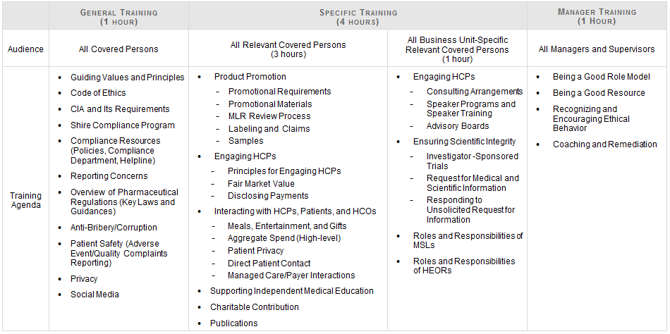
Review Detailed Curriculum Map
This table documents the proposed learning requirements for each anticipated CIA covered audiences.
Sample

Slide 21
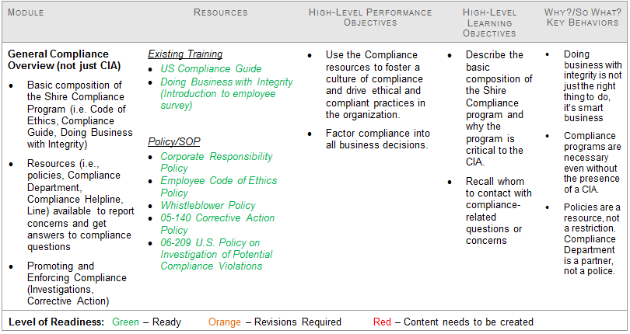
Review Detailed Curriculum Map
This table documents the topics, objectives, and current content for a proposed module in the General training.
Sample

Slide 22
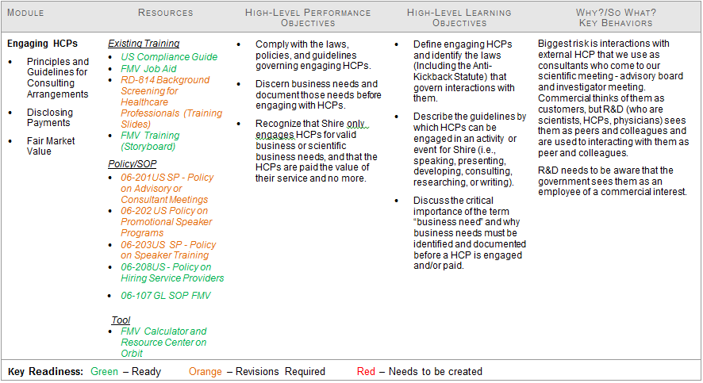
Review Detailed Curriculum Map
This table documents the topics, objectives, and current content for a proposed module in the Specific training.
Sample

Slide 23
Proposed Curriculum Map – High Level Timeline
Curriculum Map
Breakdown of learning by CIA covered audience
High-level performance goals and topics
Master DSD
Learning strategy
Characters
Backgrounds
Branding
Goals and objectives by course
Content Document
Leverage Compliance Guide
Guiding principles
Audience-specific examples and scenarios
Knowledge checks
~11/1/13
Current SOW
6/12/13
7/9/13
8/9/13
Slide updated 6/19/13

Slide 24
Proposed Curriculum Map – High Level Timeline
Storyboard
ALPHA
Revise content document based on CIA requirements
Production-ready
BETA
GOLD
~11/1/13
Training SOW
~11/1/13
~12/1/13
~12/20/13
~1/3/14
~12
Weeks
Shire Reviews (8 weeks)
~3-4
weeks
~2 - 3
weeks
~1
week

Slide 25
Proposed Curriculum Map – High Level Timeline
Curriculum Map
Content Document
Storyboard
ALPHA
Breakdown of learning by CIA covered audience
High-level performance goals and topics
Revise content document based on CIA requirements
Master DSD
Learning strategy
Guiding principles
Leverage Compliance Guide
Audience-specific examples and scenarios
Knowledge checks
Production-ready
BETA
GOLD
Characters
Backgrounds
Branding
Goals and objectives by course
~11/1/13
Current SOW
Training SOW
6/12/13
7/9/13
8/9/13
~11/1/13
~12/1/13
~12/20/13
~1/3/14
~12
Weeks
Shire Reviews (8 weeks)
~3-4
weeks
~2 - 3
weeks
~1
week

Slide 26
Proposed Curriculum Map – High Level Timeline
~10/1/13**
~1-2 weeks
Curriculum Map
Content Document
Storyboard
ALPHA
Breakdown of learning by CIA covered audience
High-level performance goals and topics
CIA
Revise content document based on CIA requirements
Master DSD
Learning strategy
Guiding principles
Leverage Compliance Guide
Audience-specific examples and scenarios
Knowledge checks
Production-ready
Revise
BETA
GOLD
Characters
Backgrounds
Branding
Goals and objectives by course
~11/1/13
Current SOW
Training SOW
6/12/13
7/9/13
8/9/13
~11/1/13
~12/1/13
~12/20/13
~1/3/14
~12
Weeks
Shire Reviews (8 weeks)
~3-4
weeks
~2 - 3
weeks
~1
week
** 10/1/13 represents potential CIA effective date

Slide 27
Next Steps
Who | What | When
Shire /PDG | Findings & Recommendations and Curriculum Roadmap Review Meeting | 6/5
Shire | Review Findings & Recommendations and Curriculum Map and provide feedback | 6/5 – 6/10 Approved 6/20
Shire | Approve Curriculum Map | 6/21
Shire | Prioritize recommendations and make decisions about how best to incorporate each | Ongoing
PDG | Continue content review | 6/13 – 6/28
PDG | Review “Business With Integrity Survey” results | 6/21
PDG | Develop Master Design Strategy and Detailed Curriculum Map | 6/13 – 6/28

Slide 28
Thank You

Slide 29
Appendices:
Detailed Methodology and Supporting Data

Slide 30

Methodology
Approach Description
Focus Groups
Conducted 5 focus group sessions with a total of 18 people representing the following business units:
Corporate Compliance Function (n=7)
R&D Compliance Function (n=3)
Sales Training (n=3)
Commercial Operations (n=1)
Clinical Training (n=2)
Regulatory Training (n=1)
PVG Quality & Training Functions (n=1)
Content Review
Conducted a high-level review of content in 18 categories to determine content readiness for inclusion in the CIA Training
Note: Due to the reorganization, Year 1 will focus on values and principles. Subsequent years will focus more on policies and procedures as they are finalized.

Slide 31
Interview Protocol
Category |  | Question
**FOCUS GROUP 1 ONLY** Expected requirements of the potential CIA
Question 1 | It is our understanding that Shire has been working with U.S. Attorney’s Office on an investigation related to allegations of improper sales and marketing practices in the Company’s Specialty Pharmaceuticals business. Does anyone have a different understanding?
Question 2 | What are the anticipated requirements for general audiences and for relevant functions?
 | Probing Question: Can you talk a little about the anticipated “covered persons” (consider existing, new hire, contractor/vendor) for the potential CIA?
Question 3 | As a member of the Compliance team here at Shire, what role do you see yourself playing in CIA Readiness and the CIA Implementation processes?
 | Probing Question: Tell me what that might look like?
Past Experience with CIA Training & Communication processes
Question 4 | Who has past experience with a CIA? What was your role and can you share a little about that experience, specifically around any training and communication?
 | Probing Question: What part of that prior experience may apply to Shire’s CIA training and communications?
Identify audience specific compliance challenges and resolutions
Question 5 | Can you give me some examples of “common” compliance challenges Shire employees face on the job?
 | Probing Question: Typically who (what role) faces this? Probing Question: How frequently does this type of issue occur?
Question 6 | How have these on the job challenges been addressed?
Question 7 | Were the interventions successful?
Question 8 | Can you share a story of … or tell me what it looks like when we’re complying with all policies…
Question 9 | Who’s the best person to talk to get additional examples, non-examples, and insights for content we need to build quickly?

Slide 32
Interview Protocol (continued)
Category | Question
Expectations of CIA Training at Shire
Question 10 | When we begin developing the CIA training, we may ask you for more specific input. For now, we would like to understand what your expectations are of the CIA training design, development, and delivery?
Discuss e-learning preferences by audience (Compliance, R&D, Sales, others?)
Question 11 | The current plan is to develop e-learning courses for General and Specific Training for covered persons. In your opinion, what works well about the current compliance (or other) e-learning at Shire, that you would like to see preserved and/or replicated?
 | Probing Question: Tell me more about….
Question 12 | In your opinion, aside from STELA challenges, what about the current compliance (or other) e-learning at Shire doesn’t work so well that you would want to stay away from for future training initiatives?
 | Probing Question: What feedback have you heard from the audience that causes you to believe it was ineffective? Probing Question: How would you modify that to be more effective?
Question 13 | What barriers (people or things) get in the way of employees in (<<department name>> completing required training as scheduled?
Other
Question 14 | Thinking “outside the box,” what ideas do you have to make delivery of compliance training more effective?
Question 15 | What do we need to know about compliance training at Shire that we haven’t talked about yet?
Question 16 | Is there anything else that I haven’t asked you that you would like to share?

Slide 33
Themes
Culture |  | 49 | Major Theme
 | General | 13 | Minor Theme
 | Change | 8 | Minor Theme
 | Communication | 8 | Minor Theme
 | Integrity | 8 | Minor Theme
 | Accountability | 6 | Minor Theme
 | Behavior | 6 | Minor Theme
Training |  | 38 | Major Theme
 | General | 17 | Minor Theme
 | Implementation | 9 | Minor Theme
 | Pull Through | 6 | Minor Theme
 | Interaction | 3 | Minor Theme
 | Re-Purpose | 3 | Minor Theme
Scenario |  | 30 | Major Theme
CIA |  | 14 | Major Theme
Leadership |  | 13 | Major Theme
Compliance Dept. |  | 11 | Major Theme
Key Behaviors |  | 10 | Major Theme
Data Points - 165
Finding Categories - 16
Major Themes – 7
Minor Themes - 11

Slide 34
Theme Distribution

Slide 35
The Classroom is not where most learning happens
Learning takes place:
70% = on the job learning, learning while doing
20% = coaching and mentoring, support and direction from managers and colleagues
10% = formal learning, whether classroom, workshop or, e-Learning
Source: Charles Jennings, Global Head of Learning for Reuters

