Slide 1

Notes:
Page ID: 6000
Audio: Music
Graphic Notes and Source File (if applicable):
Programming Notes: This page is displayed when the course launches. The sub-title for this course is: Managers and Supervisors
Clicking the start button reveals what is seen on page 2 in this ppt.

Slide 2

Course Introduction
Notes:
Page ID: 6000
Audio: Music
Graphic Notes and Source File (if applicable):
Programming Notes: Notes regarding audio is displayed when learner clicks the Next button on the course launch page. The sub-title for this course is: Managers and Supervisors

Slide 3
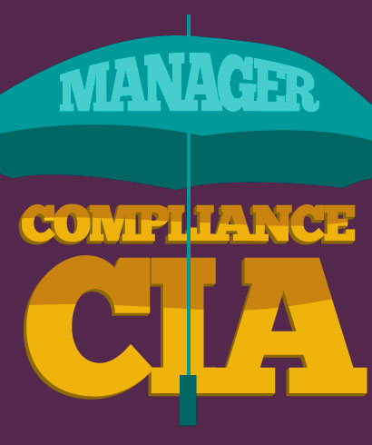
Course Introduction
Welcome
Everyone at Shire is expected to do business with integrity.
As a manager and leader, you have additional responsibilities for ensuring employees operate ethically and in compliance with all applicable laws, regulations and policies, including:
  Preventing compliance issues from occurring
  Identifying compliance problems
  Addressing and/or escalating suspected violations
  Your responsibilities under our Compliance Program extend to the CIA.
  Our Compliance Program and the CIA share the same basic objectives—promoting compliance with the law and fostering a commitment to doing business with integrity.
Notes:
Page ID: 6010
Audio: Welcome to Doing Business with Integrity. As a manager and leader, you play an important role in ensuring we operate ethically and with integrity. Everyone at Shire is expected to do business with integrity, but as a manager and leader, as you know, you have additional responsibilities for ensuring employees operate ethically and in compliance with all applicable laws, regulations and policies. This includes preventing compliance issues from occurring, identifying compliance problems and addressing and/or escalating suspected violations. Your responsibilities under Shire’s Compliance Program extend to the Corporate Integrity Agreement, or CIA. Shire’s Compliance Program and the CIA share the same basic objectives—promoting compliance with the law and fostering a commitment to doing business with integrity. This commitment to integrity and compliance is part of our culture. We are dedicated to doing the right thing each and every day in all of our activities.
Graphic Notes and Source File (if applicable): Graphic that shows that the Compliance Program and the CIA share the same goal and both fall under the manager’s area of responsibility. Maybe something using the “C” in “Compliance” and the “C” in CIA all under an umbrella that says “Manager.”
Programming Notes: None.

Slide 4
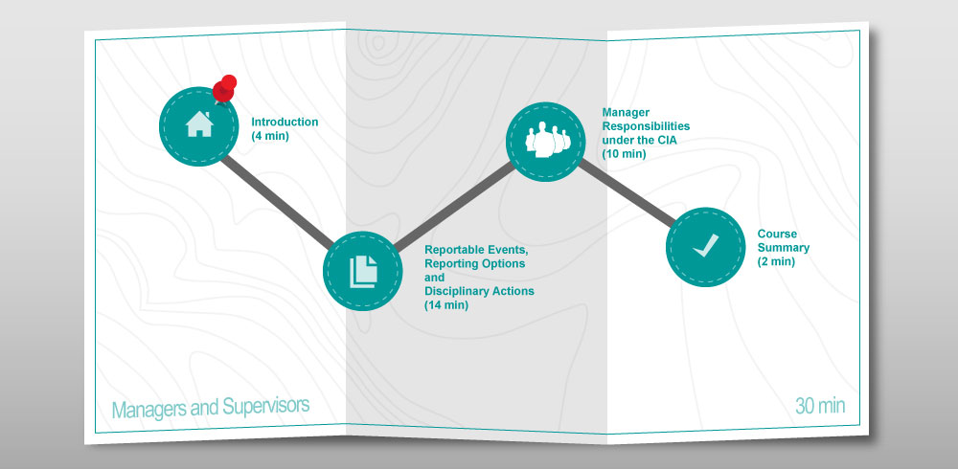
Course Introduction
Notes:
Page ID: 6020
Audio: This training is intended to provide you with the information you need to ensure that the employees who report to you are in compliance with the CIA requirements, how to report events when they are not in compliance, and possible disciplinary actions. This training will also provide you with the knowledge you need to fulfill your obligations under the CIA in regards to the Independent Review Organization, or IRO, transaction reviews, field monitoring, new hires and coordinating with data champions, as well as be a resource for your employees who have questions about the CIA.
Graphic Notes and Source File (if applicable): Course map with four modules. Pushpin on Course Introduction.
Course Introduction (4 minutes) (icon – outline of a house)
Reportable Events, Reporting Options and Disciplinary Actions (14 minutes) (icon – stack of papers)
Manager Compliance Responsibilities under the CIA (10 minutes) (icon – Outline of a person with many people behind him)
Course Summary (2 minute) (icon – checkmark)
Programming Notes: In the menu, this page should appear as “Course Agenda”

Slide 5
Course Introduction
Title: Displays the titles of the current module that you are viewing.
Exit: Click at any time to exit the course. When you exit the course using this Exit button, the course saves your place. When you return to the course later, you have the option to begin where you left off or start from the beginning of the course.
Menu: Click here to see a list of course topics. You must complete this course in order. Once you have completed a topic, you may return to that topic at any time.
Resources: Click for additional information and resources.
Transcript: Click here to view the audio transcript for each screen. You may open and close the transcript window at any time.
Course Progress: This bar shows your progress in the course.
Previous: Click the back arrow to go back to the previous screen.
Next: Click the forward arrow to go to the next screen.
Notes:
Page ID: 6030
Audio: Take a moment to become familiar with the navigational features of this course. When you’re ready, click Next to continue.
Programming Notes: Menu title is “Course Navigation.”

Slide 6
Course Introduction
Getting Started
This course will take you approximately 30 minutes to complete.
Here are a few tips for completing this course:
Complete modules in their given order
Complete all components of a screen to activate the Next button
Return to completed pages at any time to review the content
Listen to narration or click the Transcript icon to read the audio transcript
Complete knowledge checks and practice activities
To receive credit for this course, you must complete all the modules in their entirety.
Notes:
Page ID: 6040
Audio: This course will take you approximately 30 minutes to complete. You will complete the modules in their given order. You must complete all components of a screen to activate the Next button. Once you have completed a screen, you may return to that screen at any time during the course. If you choose to turn off the audio, you must click the Transcript icon to read the audio transcript.
Throughout the course, you will encounter knowledge checks and practice activities. These questions aren’t scored. But they will help you gauge your understanding and application of the material. To receive credit for this course, you must complete all the modules in their entirety.
Graphic Notes and Source File (if applicable): Standard graphic for all courses.
Programming Notes: None

Slide 7
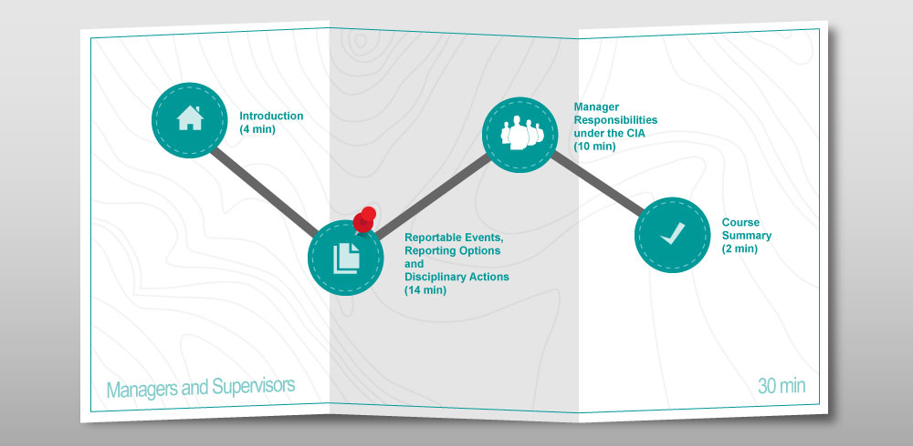
Reportable Events, Reporting Options and Disciplinary Actions
Notes:
Page ID: 6050
Audio: On a daily basis, you are responsible for ensuring your teams do business with integrity. This includes ensuring alignment between employee performance and our BRAVE culture and values, and ensuring that employees’ activities are in compliance with applicable laws and regulations, including the CIA. Thus, it is important that you understand how to identify whether an employee or team member is not in compliance. When a potential ethics or compliance issue occurs, some form of disciplinary or remedial action may need to be taken. The action taken will depend on the severity of the problem. This module, Reportable Events, Reporting Options, and Disciplinary Actions, will provide guidance on how to identify suspected CIA compliance or misconduct violations, known as “reportable events,” how to report those events, and identify the types of disciplinary actions for non-compliance.
Graphic Notes and Source File (if applicable): Course map with four modules. Pushpin on Reportable Events, Reporting Options and Disciplinary Actions.
Course Introduction (4 minutes) (icon – outline of a house)
Reportable Events, Reporting Options and Disciplinary Actions (14 minutes) (icon – stack of papers)
Manager Responsibilities under the CIA (10 minutes) (icon – Outline of a person with many people behind him)
Course Summary (2 minute) (icon – checkmark)
Programming Notes: Title of this page in the Menu is “Module Introduction”

Slide 8

Reportable Events, Reporting Options and Disciplinary Actions
What are Reportable Events?
  A matter that a reasonable person would consider a probable violation of:
    Criminal laws
    Civil laws
    Administrative laws applicable to any Federal healthcare program for which there may be penalties or exclusion
    Administrative laws applicable to any FDA requirements relating to the promotion of Government Reimbursed Products (e.g., off-label promotions)
  The employment or contracting with a Covered Person who is ineligible
  The filing of a bankruptcy petition by Shire
Notes:
Page ID: 6060
Audio: A reportable event is defined under the CIA as a matter that a reasonable person would consider a probable violation of criminal, civil, or administrative laws, the employment of or contracting with a Covered Person who is an Ineligible Person under the CIA, or the filing of a bankruptcy petition by Shire.
Graphic Notes and Source File (if applicable): 135566239. Add words “Reportable Events” across the top of the notebook page.
Programming Notes:

Slide 9

Reportable Events, Reporting Options and Disciplinary Actions
Reporting Reportable Events
The event must be reported, in writing, to the Office of Inspector General (OIG), within 30 days after Shire determines the event exists.
The report must include: a complete description of the Reportable Event, Shire's actions taken to correct it, and any steps Shire plans to take to prevent its reoccurrence.
Notes:
Page ID: 6080
Audio: Whether a Reportable Event is the result of an isolated event or a series of occurrences, it must be reported in writing to the OIG within 30 days after making the determination that Reportable Event exists. The report must include a complete description of the Reportable Event, Shire's actions taken to correct the event, and any further steps Shire plans to take to address the event and prevent its reoccurrence.
Graphic Notes and Source File (if applicable): iStock_000000929933Small
Programming Notes:

Slide 10

Reportable Events, Reporting Options and Disciplinary Actions
Responsibility to Report Events of
Non-Compliance
Shire employees are encouraged to promptly report any suspected or potential issues of non-compliance.
No penalty nor retaliation for making any report in good faith.
Employees who know about instances of non-compliance and do not report them may be subject to disciplinary action.
Employees who knowingly make false reports are subject to disciplinary action.
Keep open lines of communication.
Notes:
Page ID: 6090
Audio: As part of our BRAVE culture, all Shire employees are encouraged to promptly report any suspected or potential issues of non-compliance to their manager or supervisor, a colleague in the Compliance or Legal department or through the Compliance Helpline. Employees, vendors, contractors, and business partners will not be penalized nor will there be any retaliation for making any report in good faith. But, employees who know about instances of non-compliance and do not report them may be subject to disciplinary action. Additionally, employees who knowingly make false reports are also subject to disciplinary action. As a manager, you are in the best position to know the context and circumstances of the questions or concerns a member of your team may have and provide them with the fastest response. As you learned previously, Lines of Communication is a key element of any effective compliance program and that includes open lines of communication between employees and managers.
Graphic Notes and Source File (if applicable): iStock_000017251844Small
Programming Notes:

Slide 11

Reportable Events, Reporting Options and Disciplinary Actions
Non-Retaliation Policy
Shire wishes to establish an environment in which all employees feel able to report suspected non-compliance events or any other concerns, in good faith and without fear of discrimination or reprisal.
Employees who speak out :
  Will be regarded as acting in good faith
  Have all disclosures treated confidentially
  Will be protected from reprisals
Notes:
Page ID: 6100
Audio: Shire wishes to establish an environment in which all employees feel able to report suspected breaches of laws, regulations and codes, or any other concerns of malpractice, in good faith and without fear of discrimination or reprisal. Therefore, employees who speak out will be regarded as acting in good faith, all disclosures will be treated confidentially except as agreed with the employee and as necessary and proper for appropriate resolution, and the employee will be protected from reprisals.
Graphic Notes and Source File (if applicable): 135547450
Programming Notes:

Slide 12

Reportable Events, Reporting Options and Disciplinary Actions
Reportable Events and Reporting Options
Brian tells you that a colleague, Sam, bought tickets to a baseball game for a physician and joked that he hoped the physician remembered the gesture. What do you tell Brian to do?
Wait to see if Sam tells his manager. It is his responsibility.
Talk to Sam’s manager and then he no longer needs to be concerned with it.
Report the issue immediately to Compliance and Legal.
Do nothing if Sam was joking, especially since Sam could cause problems for Brian.
Notes:
Page ID: 6110
Audio: A member of your team, Brian, comes to you and tells you that a colleague, Sam, mentioned to him that he bought tickets to a baseball game for a physician at Midtown Hospital. Brian says Sam joked that he hoped the physician remembered the gesture down the road. Brian is concerned this may be a violation. What do you tell Brian to do?
Graphic Notes and Source File (if applicable): Standard KC graphic
Programming Notes: Page title should appear in Menu as “Knowledge Check: Reportable Events and Reporting Options”
Incorrect answer: Wait to see if Sam tells his manager. It is his responsibility.
Feedback: Incorrect. Employees who know about instances of non-compliance and do not report them may be subject to disciplinary action. Click Reset to try again.
Incorrect answer: Talk to Sam’s manager and then he no longer needs to be concerned with it.
Feedback: Incorrect. Though talking to Sam’s manager is a correct and proper first step, Brian should still ensure the action is followed up on. Employees who know about instances of non-compliance and do not report them may be subject to disciplinary action. Click Reset to try again.
Correct answer: Report the issue immediately to Compliance and Legal.
Feedback: Correct. Shire employees are encouraged to promptly report any suspected or potential issues of non-compliance. There will not be any penalty nor retaliation for making any report in good faith, but employees who know about instances of non-compliance and do not report them may be subject to disciplinary action. Click the Next button to continue.
Incorrect answer: Do nothing if Sam was joking, especially since Sam could cause problems for Brian.
Feedback: Incorrect. Even if Sam was joking, his behavior could be viewed as a violation of the Anti-Kickback Statute and/or as a form of bribery.
Employees who know about instances of non-compliance and do not report them may be subject to disciplinary action. Furthermore, under Shire’s Non-Retaliation policy, employees who speak out will be protected from reprisals. Click Reset to try again.

Slide 13

Reportable Events, Reporting Options and Disciplinary Actions
Possible Disciplinary Actions
When disciplinary action is needed, you should discuss the appropriate action to take with a Human Resources business partner. Possible actions may include any one of the following.
Verbal Warning
Written Warning
Suspension
Termination of Employment
Notes:
Page ID: 6120
Audio: When a violation or reportable event occurs, and disciplinary action is needed, you, as manager, should discuss the appropriate action to take with a Human Resources business partner, taking into consideration the nature and circumstances of the event. Possible corrective actions may include any one of the following.
Graphic Notes and Source File (if applicable): 86484828
Programming Notes:
Verbal Warning: Verbally, describe specific examples of the unsatisfactory conduct, practices or behavior; the requirements for improvement; and the timeframe in which the improvement must occur. It is your responsibility, as manager, to the employee that he/she is being placed on a verbal notification regarding performance, and that he/she is not complying with the standards or expectations of the job.
Written Warning: Describe, in writing, the unsatisfactory conduct, practices or behavior; the measures needed to correct the problem; and the time within which the problem must be corrected. This must then be hand delivered to the employee and signed by both the manager and the employee acknowledging receipt of the written warning (though not necessarily agreement of the employee).
Suspension: Suspension may be used as a disciplinary action or when an investigation is being conducted regarding allegations against an employee for gross misconduct, such as, sexual harassment, misappropriation of funds, violent behavior, or other grossly unsatisfactory conduct, practices or behavior. During the suspension period the employee may or may not be paid at his/her regular full time rate.
Termination of Employment: Employment is terminated when the offence justifies such action or when other means of discipline have been implemented and have not been effective in curing the problems identified. Depending upon the seriousness of the employee’s conduct, immediate termination of employment may be appropriate. All involuntary terminations should be discussed with the next level of management and your Human Resources business partner.

Slide 14
Reportable Events, Reporting Options and Disciplinary Actions
Module Summary
You are in the best position to know what is going on with your team. Your responsibilities include ensuring:
  Alignment with our BRAVE culture and values
  Compliance with applicable laws and regulations, including the CIA
You need to be able to identify reportable events and ensure such events are reported in an appropriate manner.
All Shire employees are encouraged to promptly report any suspected or potential issues of non-compliance.
Employees who speak out will be protected from reprisals.
When a violation or reportable event does occur, disciplinary action may be taken up to and including termination.
Notes:
Page ID: 6130
Audio: As a manager, you are in the best position to know what is going on with your team and thus one of your responsibilities is to make sure that there is alignment between your team’s performance and our BRAVE culture and values, and that your team’s activities are in compliance with applicable laws and regulations, including the CIA. Thus, it is important that you understand how to identify reportable events or matters that a reasonable person would consider a probable violation of criminal, civil, or administrative laws, and/or the CIA and ensure such violations are reported in an appropriate manner. All Shire employees are encouraged to promptly report any suspected or potential issues of non-compliance and employees who speak out will be regarded as acting in good faith and be protected from reprisals. When a violation or reportable event does occur, disciplinary action may be taken up to and including termination.
Graphic Notes and Source File (if applicable):
Programming Notes:

Slide 15
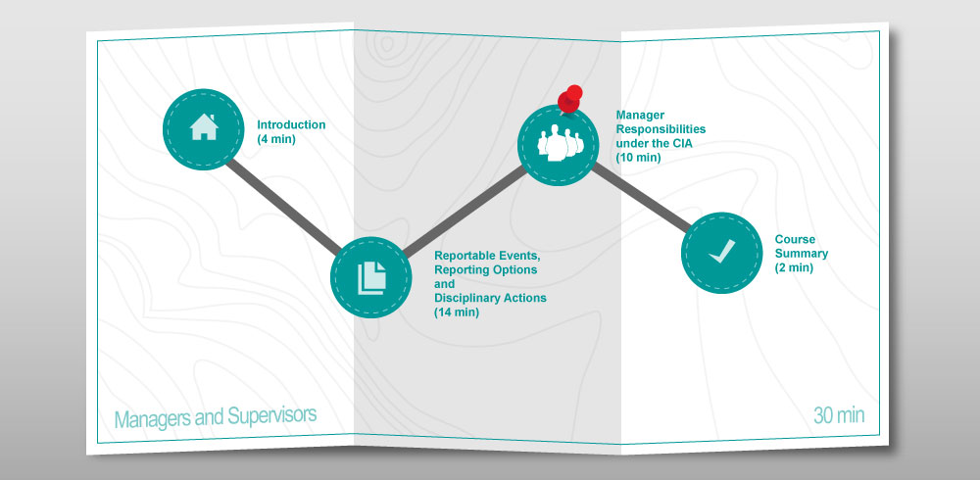
Manager Responsibilities under the CIA
Notes:
Page ID: 6140
Audio: In addition to preventing compliance issues from occurring, identifying compliance problems and addressing and/or escalating suspected violations, as a manager you have other responsibilities to ensure you, your team, and Shire are in compliance with other aspects of the CIA. This module, Manager Compliance Responsibilities under the CIA , explains your responsibilities for IRO transaction reviews, the Field Monitoring Program, certifying compliance with CIA requirements specific to new hires, and management certifications including coordinating with the Data Champion.
Graphic Notes and Source File (if applicable): Course map with four modules. Pushpin on Manager Compliance Responsibilities under the CIA.
Course map with four modules. Pushpin on Reportable Events, Reporting Options and Disciplinary Actions.
Course Introduction (4 minutes) (icon – outline of a house)
Reportable Events, Reporting Options and Disciplinary Actions (14 minutes) (icon – stack of papers)
Manager Compliance Responsibilities under the CIA (10 minutes) (icon – Outline of a person with many people behind him)
Course Summary (2 minute) (icon – checkmark)
Programming Notes: Title of this page in the Menu is “Module Introduction”

Slide 16

Manager Responsibilities under the CIA
IRO Review Oversight Information
Under the CIA, we are required to coordinate with an IRO to ensure they have the information and access necessary to conduct independent process and transactional reviews.
IRO Responsibilities
Types of IRO Reviews
Compliance Department Responsibilities
Business Owner Responsibilities
Notes:
Page ID: 6150
Audio: Though we conduct rigorous monitoring activities to ensure that our policies and procedures are being followed, under the CIA, we are also required to coordinate with an IRO to ensure they have the materials, documentation, and access to appropriate business owners to ensure they can conduct their independent process and transactional reviews in a timely manner.
Graphic Notes and Source File (if applicable): iStock_000003309389Small
Programming Notes:
IRO Responsibilities: An IRO is an accounting, auditing, or consulting firm which serves an independent audit-like function on behalf of the Office of Inspector General. The retention of an IRO is required by the CIA. The annual process will begin about 6 months after the CIA effective date. Potential areas of review will vary and some companies may have “unique” requirements based upon the issues from the investigation. The IRO may also select up to 3 additional areas to review at their discretion.
Types of IRO Reviews
Process Reviews: As the first step, the IRO conducts interviews with the business owners, reviews any related Policies and SOPs, and any related IT systems. If there no changes to any Shire processes, this review will occur in Year 2 and Year 5. If there are changes, it will occur annually.
Transactional Reviews: Certain areas will have transactional reviews conducted annually. To complete the review, the IRO picks a random sample of “auditable” transactions (any occurring after the CIA effective date) and tests them against the Process Review documents to ensure the process is being followed. The IRO will compile a report which is submitted to OIG. Shire then needs to address any findings. Our goal is to minimize the findings.
Compliance Department Responsibilities: The Compliance Department is responsible for overall management of the IRO, coordinating IRO planning and scheduling, and facilitating the workflow and approve materials for submission to IRO.
Business Responsibilities: The business responsibilities are to provide documentation, including SOPs and transactional data, as required in a timely manner, and participating in IRO interviews as subject matter experts when appropriate.

Slide 17

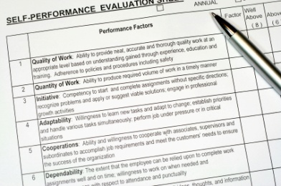

Manager Responsibilities under the CIA
Field Force Monitoring Program
Under the CIA, all interactions between Shire personnel and customers and consumers are subject to monitoring. Trained personnel will conduct full day ride-alongs with sales reps.
Selection and Scheduling
Criteria
Reporting and Follow-Up
Notes:
Page ID: 6160
Audio: Under the CIA, all interactions between Shire personnel and customers and consumers are subject to monitoring. Specifically, appropriately trained personnel who are independent from the monitored functional area, will conduct full day ride-alongs with sales representatives to assess whether the messages delivered and materials distributed to HCPs during sales calls are consistent with applicable legal and regulatory requirements and Shire policies and procedures.
Graphic Notes and Source File (if applicable): Selection and Scheduling: 86480754, Criteria: iStock_000004839052XSmall, Reporting and Follow-Up: 140385515
Programming Notes:
Selection and Scheduling: Sales representatives shall be selected for field visits based on a sampling approach using the following variables: Business Unit (BU), Sales Role and Geographic Region. Sales representatives will also be selected for field visits based on data acquired from various channels related to compliance. In these situations, the purpose of the selection is to acquire more information regarding a potential compliance concern. The nature of the assignment may not be disclosed to the sales representative or his/her manager if it is determined disclosure may adversely impact the monitoring activities. Once selected, the appropriate Regional Director (RD) will be contacted three weeks in advance of scheduling a field visit to ensure the sales representative is available. Once the assessment date is confirmed with the RD, the sales representative is contacted to discuss logistics and address any questions or concerns the representative may have.
Criteria: Assessment criteria is based on applicable laws, regulations, and Shire policies and procedures. Monitors will use a standardized monitoring report to document each field assessment. At a minimum, the following activities will be observed and recorded:
Promotional activities
Use of MLR-approved messages and materials
Fair/Balanced delivery of promotional messages
Proper handling of off-label inquiries
Use of appropriate prompts or conversation starters
Compliance and ethics activities
Proper use of product samples
Adverse Event Reporting
Transparency reporting for in-office meals
Reporting and Follow up: In the absence of any Legal document hold mandates, field assessment reports will be retained for seven (7) years. The feedback recorded on the monitoring report will be provided to the sales representative during the field assessment and an assessment summary will be provided to the representative at the conclusion of the assessment activities. Additionally, the representative’s Regional Director will be contacted to review the assessment findings. The data from the Sales Call Assessment monitoring reports will be aggregated to identify overall compliance trends across activities and to determine potential training opportunities. Compliance trends detected from the analysis of aggregate data will be used to support future data-supported monitoring selections.

Slide 18
Placeholder. Waiting for content from client.
Manager Responsibilities under the CIA
Monitoring of Non-Promotional Activities
Notes:
Page ID: 6170
Audio:
Graphic Notes and Source File (if applicable):
Programming Notes:

Slide 19
Placeholder. Waiting for content from client.
Manager Responsibilities under the CIA
Monitoring Programs
Notes:
Page ID: 6180
Audio: Let’s see what you have learned. Select the best response to the question and click submit.
Graphic Notes and Source File (if applicable):
Programming Notes: Page title should appear in Menu as “Knowledge Check: Monitoring Programs”
Incorrect answer:
Feedback: Incorrect. Click Reset to try again.
Correct answer:
Feedback: Correct.. Click the Next button to continue.

Slide 20

Manager Responsibilities under the CIA
CIA Requirements Specific to New Hires
All new employees must complete all required training within 30 days of their hire date.
All additional required training must be completed annually thereafter for the duration of their employment.
Managers need to make sure new hires and transfers know the deadline and the importance of not missing it.
Shire faces fines for each day that they are not in compliance with the training requirements.
Notes:
Page ID: 6190
Audio: The CIA requires that all new employees complete all required training within 30 days of their hire date at Shire and all additional required training annually thereafter for the duration of their employment. Managers need to make sure New Hires and transfers know the deadline and how important it is to not miss the deadline. Shire faces fines for each day that they are not in compliance with the training requirements.
Graphic Notes and Source File (if applicable): iStock_000009910956Small
Programming Notes: None

Slide 21




Manager Responsibilities under the CIA
Certification Roles and Responsibilities
Covered Persons must ensure that they and individuals reporting to them are in compliance. This is documented through a series of CIA-required certifications, and a resolution from the Board.
Compliance Department
Manager
Data Champion
Company Board
Notes:
Page ID: 6200
Audio: Management certification is one of the requirements of the CIA. Covered Persons must ensure that they and the individuals that report to them are in compliance. This assurance is documented through a series of CIA-required certifications, leading to a resolution from the Company Board.
Graphic Notes and Source File (if applicable): Compliance Department: iStock_000008336783Small, Manager: 80620996, Data Champion: iStock_000008580905XSmall, Company Board: 99394575
Programming Notes:
Compliance Department Responsibilities: Administer Management Certifications to Senior Management as required.
Manager Responsibilities: Managers certify that their associates are in compliance with all US federal healthcare program requirements and FDA requirements, and the terms of our CIA. These certifications should be in timely manner.
Data Champion Responsibilities: Each BU/Function Leader nominates a Shire employee to be a “Data Champion.” This is a 2 year commitment during which the Data Champion collaborates with colleagues to collect the required compliance data and updates the required data twice a month.
Company Board Responsibilities: The Company Board ensures, via a resolution, that Shire has an effective compliance program to meet US federal healthcare program requirements and FDA requirements, and the terms of our CIA.

Slide 22
Placeholder. Waiting for content from client.
Manager Responsibilities under the CIA
Certifying Employees
Notes:
Page ID: 6210
Audio:
Graphic Notes and Source File (if applicable):
Programming Notes:

Slide 23
Manager Responsibilities under the CIA
Certifications
Which of the following is a TRUE statement about certification responsibilities under the CIA?
The Data Champion in each BU certifies that their associates are in compliance with all requirements, and the terms of our CIA
The responsibilities of the Data Champion include collecting all required compliance data and updating the data twice a month in the system
TBC based on additional content
Our compliance is documented through a series of CIA-required certifications, leading to a resolution from the Compliance Department.
Notes:
Page ID: 6220
Audio: Let’s see what you have learned. Select the best response to the question and click Submit.
Graphic Notes and Source File (if applicable): Standard graphic
Programming Notes: Page title should appear in Menu as “Knowledge Check: Certifications”
Incorrect answer: The Data Champion in each BU certifies that their associates are in compliance with all requirements, and the terms of our CIA
Feedback: Incorrect. Managers certify that their associates are in compliance with all US federal healthcare program and FDA requirements, and the terms of our CIA. Click Reset to try again.
Correct answer: The responsibilities of the Data Champion include collecting all required compliance data and updating the data twice a month in the system
Feedback: Correct. Each BU/Function Leader nominates a Shire employee to be a “Data Champion” for two years. The Data Champion collaborates with colleagues to collect the required compliance data and updates the required data twice a month. Click the Next button to continue.
Incorrect answer:
Feedback: Incorrect. Click Reset to try again.
Incorrect answer: Our compliance is documented through a series of CIA-required certifications, leading to a resolution from the Compliance Department.
Feedback: Incorrect. Our compliance is documented through a series of CIA-required certifications, leading to a resolution from the Company Board. Click Reset to try again.

Slide 24

Manager Responsibilities under the CIA
FAQs
One of your responsibilities as a manager is to be a resource for employees who have questions about CIA. Here are some comments or questions you may here and suggested responses.
“Now that we have a CIA, I need to be absolutely perfect at my job. That’s really stressful!”
“Compliance, the CIA , all these rules are getting in the way of my job!”
“ I don’t think the CIA has anything to do with my function.”
“I already know how to do my job! Why all this training?”
Notes:
Page ID: 6230
Audio: As mentioned earlier, one of your responsibilities as a manager is to be a resource for employees who have questions about CIA. Here are some questions you may here and suggested responses.
Graphic Notes and Source File (if applicable): iStock_000010170863XSmall
Programming Notes:
Header:“Now that we have a CIA, I need to be absolutely perfect at my job. That’s really stressful!”
Reveal Text: Shire’s ethical approach is we don't expect perfection, we expect excellence, and we always have.
Header: “Compliance, the CIA , all these rules are getting in the way of my job!”
Reveal Text: Think of Compliance as resource, not a restriction, a partner, not a police. Compliance is not a barrier to achieving your business objectives. It's making sure you achieve your business without adverse ramification.
Header: “ I don’t think the CIA has anything to do with my function.”
Reveal Text: Compliance is everyone’s responsibility. Adhering to legal requirements and following all policies is the responsibility of each person in every division. We share this responsibility with our vendors, and external business partners.
Header: “I already know how to do my job! Why all this training?”
Reveal Text: We work in a highly complex, highly regulated environment that is evolving rapidly. This training will help you operate effectively by adhering to our policies, regulatory requirements, and the law. With a clearer understanding of our Company-wide of our policies and processes, we will operate more efficiently than ever.

Slide 25
Manager Responsibilities under the CIA
Module Summary
As a manager you have many responsibilities to ensure you, your team, and Shire are in compliance with other aspects of the CIA. These include:
  Assisting with IRO reviews
  Ride-alongs with sales representatives
  Ensuring compliance with training requirements and new hires
  Managing certifications in coordination with the Data Champion
Notes:
Page ID: 6240
Audio: As a manager you have many responsibilities to ensure you, your team, and Shire are in compliance with other aspects of the CIA. This includes assisting with the coordination of IRO reviews, taking part in ride-alongs with sales representatives to assess their compliance, ensuring compliance with CIA requirements related to training and new hires, and managing certifications in coordination with the Data Champion.
Graphic Notes and Source File (if applicable):
Programming Notes:

Slide 26

Course Summary
Notes:
Page ID: 6250
Audio: In this module, the Course Summary, we will review your key learnings.
Graphic Notes and Source File (if applicable): Course map with four modules. Pushpin on Reportable Events, Reporting Options and Disciplinary Actions.
Course map with four modules. Pushpin on Course Summary.
Course Introduction (4 minutes) (icon – outline of a house)
Reportable Events, Reporting Options and Disciplinary Actions (14 minutes) (icon – stack of papers)
Manager Compliance Responsibilities under the CIA (10 minutes) (icon – Outline of a person with many people behind him)
Course Summary (2 minute) (icon – checkmark)
Programming Notes: Title of this page in the Menu is “Module Introduction”

Slide 27

Course Summary
Course Summary
As a manager, you have many responsibilities including:
  Ensuring that employees who report to you are in compliance
  Reporting events of non-compliance
  Knowing the possible disciplinary actions, so that you can take the appropriate steps and counsel your team members
  Fulfilling obligations in regards to IRO transaction reviews, field monitoring, new hires, and coordinating with data champions
  Being a resource for your team
  Keep the lines of communication open to ensure your compliance, your team’s compliance and Shire’s compliance.
Notes:
Page ID: 6260
Audio: Though everyone at Shire is expected to do business with integrity, as a manager and leader, you have additional responsibilities. This includes ensuring that the employees who report to you are in compliance with the all applicable laws and regulations, including the CIA, and reporting events of non-compliance. When a potential ethics or compliance issue occurs, some form of disciplinary or remedial action may need to be taken. The action taken will depend on the severity of the problem, and it is important that you are aware of the possible actions, so that you can take the appropriate steps and counsel your team members as needed. In addition, as a manager, you have other responsibilities including obligations in regards to IRO transaction reviews, field monitoring, new hires, and coordinating with data champions. Most importantly though, you, as a manager, are in the best position to be a resource for your team and provide them with a fast response to any questions or concerns they may have. Remember to keep the lines of communication open so that you can be in an ideal position to ensure your compliance, your team’s compliance and Shire’s compliance.
Graphic Notes and Source File (if applicable): iStock_000010896706Small
Programming Notes: None

Slide 28
Course Summary
Congratulations!
You have completed this course. To exit and receive course credit, click the Exit button in the top right corner.
Notes:
Page ID: 6270
Audio: Congratulations! You have completed this course. To exit and receive course credit, click the Exit button in the top right corner.
Graphic Notes and Source File (if applicable): Standard image for all courses.
Programming Notes: Standard screen for all courses.

